Slide 1
Chapter 2
Essential Chemistry for Biology

Slide 2
Matter: Elements원소 and Compounds화합물
Matter물질 is anything that occupies space and has mass.
Matter is found on Earth in three physical states:
Solid, liquid, and gas.
Mass질량 is a measure of the amount of material in an object.
An element is a substance that cannot be broken down into other substances by chemical reactions.
All matter is composed of chemical elements.
Notes:
2
Student Misconceptions and Concerns
1. The dangers posed by certain chemicals in our food and broader environment often mislead people to associate “chemicals” with harm. People might not want “chemicals” added to their food or present in their environment. Students often fail to appreciate the chemical nature of our bodies and our world and the potential harm or benefits of naturally occurring chemistry. They often fail to understand why “natural” does not necessarily mean “good.” (Consider presenting a long list of naturally occurring toxins to make this point.) Your class may benefit from a class discussion of these misconceptions about our attitudes toward “chemicals.”
2. Students with limited backgrounds in chemistry and physics might struggle with basic concepts of mass, weight, compounds, elements, and isotopes. It may also be early in the semester, when mature study habits have not yet developed. Consider passing along basic studying advice and tips to help students master these early chemistry concepts. In-class quizzes (graded or not) or a few homework problems will also provide reinforcing practice.
3. The half-lives of many radioactive substances, especially those used for dating fossils, might lead some students to expect very long periods of decay for any radioactive substance. This might even be alarming if students are someday asked to consume a radioactive substance for a medical test. However, some medically significant isotopes have relatively short half-lives. Radioactive iodine-131 is often used to diagnose or treat certain thyroid problems. Its half-life of 8 days means that it will decay quickly.
Teaching Tips
1. Students might be interested in the following aside: One of the challenges of raising captive, exotic animals is meeting the unique dietary requirements of the species. A zoo might have trouble keeping a particular animal because science has not fully determined what trace elements the animal requires.
2. Many breakfast cereals are fortified with iron. A person can crush the cereal and extract distinct iron particles with a magnet. An overhead projector or video imagining device should clearly reveal the iron particles stuck to the magnet. This short practical demonstration can help connect an abstract concept to a concrete example.
3. Students with limited backgrounds in chemistry will benefit from a discussion of Figure 2.7 and the differences and limitations of diagrams of atomic structures. The contrasts in Figure 2.7 are a good beginning of such a discussion.
4. Here is a comparison that helps make the point about the differences in mass of protons and electrons. If a proton is as massive as a bowling ball, an electron will be the mass of a Life Saver candy. (This is calculated by considering a 15-pound bowling ball, a Life Saver with a mass of 0.12 ounces, and the textbook’s formula that an electron is 1/2,000 the mass of a proton.)
5. Here is an analogy regarding the size of a helium atom. If a helium atom were the size of a major league baseball stadium, the nucleus would be about the size of a pea near the pitcher’s mound, and the two electrons would be like tiny gnats buzzing around the stadium. This analogy helps to relate the great distances between parts of an atom. Consider modifying the analogy to any local stadium in your region.
6. After sharing teaching tips 4 and 5 above, consider asking your students to compare the mass of the pea near the pitcher’s mound to the mass of one of the gnats orbiting the stadium. If a proton or neutron is about 2,000 times more massive than an electron, how does the mass of a helium nucleus compare to the mass of one of its electrons?
7. Have your students try to calculate the number of covalent bonds possible for a variety of atoms. Then provide the students with a list of elements and the number of outer electrons for each and have them make predictions about the chemical formula for many types of molecules.
8. Consider challenging your students to suggest relationships in human lives that are analogous to each of the three main types of chemical bonds (covalent, ionic, and hydrogen). Evaluating the accuracy of potential analogies requires careful analysis of the chemical bonding relationships and critical thinking skills. Small groups might provide immediate critiques before passing along analogies for the entire class to consider. The following is one example. Ionic and covalent bonds are different types of relationships. Consider this analogy. A woman taking out a loan has a specific relationship to her bank. She owes the bank money, something she got from the bank. A man shares an office with another man. Both look out the same window and answer the same phone. Ionic bonds are like a bank loan, in which something is borrowed. Covalent bonds are like sharing an office, with items (electrons) shared by both members of the relationship. After presenting this analogy, ask your students to modify the office analogy to represent a polar covalent bond. (Perhaps one man in the office sits closer to the window and the phone.)
9. As noted in the text, chemical reactions do not create or destroy matter. Instead, they rearrange the structure and form new relationships. This is much like shuffling and dealing cards. When playing poker, cards are not created nor destroyed. Instead, new combinations are formed as the cards are dealt to the players.
Active Lecture Tips
1. See the Essay Electrons and Ceiling Fans on the Instructor Exchange. Visit the Instructor Exchange in the MasteringBiology instructor resource area for a description of this activity.
2. See the Essay Relating Chemical Bonds to Everyday Ideas on the Instructor Exchange. Visit the Instructor Exchange in the MasteringBiology instructor resource area for a description of this activity.

Slide 3
Matter: Elements and Compounds
There are 92 naturally occurring elements. Examples are
carbon,
oxygen, and
gold.
Each element has a symbol derived from its English, Latin, or German name.
Elements can combine to form compounds, substances that contain two or more elements in a fixed ratio.
Notes:
3
Student Misconceptions and Concerns
1. The dangers posed by certain chemicals in our food and broader environment often mislead people to associate “chemicals” with harm. People might not want “chemicals” added to their food or present in their environment. Students often fail to appreciate the chemical nature of our bodies and our world and the potential harm or benefits of naturally occurring chemistry. They often fail to understand why “natural” does not necessarily mean “good.” (Consider presenting a long list of naturally occurring toxins to make this point.) Your class may benefit from a class discussion of these misconceptions about our attitudes toward “chemicals.”
2. Students with limited backgrounds in chemistry and physics might struggle with basic concepts of mass, weight, compounds, elements, and isotopes. It may also be early in the semester, when mature study habits have not yet developed. Consider passing along basic studying advice and tips to help students master these early chemistry concepts. In-class quizzes (graded or not) or a few homework problems will also provide reinforcing practice.
3. The half-lives of many radioactive substances, especially those used for dating fossils, might lead some students to expect very long periods of decay for any radioactive substance. This might even be alarming if students are someday asked to consume a radioactive substance for a medical test. However, some medically significant isotopes have relatively short half-lives. Radioactive iodine-131 is often used to diagnose or treat certain thyroid problems. Its half-life of 8 days means that it will decay quickly.
Teaching Tips
1. Students might be interested in the following aside: One of the challenges of raising captive, exotic animals is meeting the unique dietary requirements of the species. A zoo might have trouble keeping a particular animal because science has not fully determined what trace elements the animal requires.
2. Many breakfast cereals are fortified with iron. A person can crush the cereal and extract distinct iron particles with a magnet. An overhead projector or video imagining device should clearly reveal the iron particles stuck to the magnet. This short practical demonstration can help connect an abstract concept to a concrete example.
3. Students with limited backgrounds in chemistry will benefit from a discussion of Figure 2.7 and the differences and limitations of diagrams of atomic structures. The contrasts in Figure 2.7 are a good beginning of such a discussion.
4. Here is a comparison that helps make the point about the differences in mass of protons and electrons. If a proton is as massive as a bowling ball, an electron will be the mass of a Life Saver candy. (This is calculated by considering a 15-pound bowling ball, a Life Saver with a mass of 0.12 ounces, and the textbook’s formula that an electron is 1/2,000 the mass of a proton.)
5. Here is an analogy regarding the size of a helium atom. If a helium atom were the size of a major league baseball stadium, the nucleus would be about the size of a pea near the pitcher’s mound, and the two electrons would be like tiny gnats buzzing around the stadium. This analogy helps to relate the great distances between parts of an atom. Consider modifying the analogy to any local stadium in your region.
6. After sharing teaching tips 4 and 5 above, consider asking your students to compare the mass of the pea near the pitcher’s mound to the mass of one of the gnats orbiting the stadium. If a proton or neutron is about 2,000 times more massive than an electron, how does the mass of a helium nucleus compare to the mass of one of its electrons?
7. Have your students try to calculate the number of covalent bonds possible for a variety of atoms. Then provide the students with a list of elements and the number of outer electrons for each and have them make predictions about the chemical formula for many types of molecules.
8. Consider challenging your students to suggest relationships in human lives that are analogous to each of the three main types of chemical bonds (covalent, ionic, and hydrogen). Evaluating the accuracy of potential analogies requires careful analysis of the chemical bonding relationships and critical thinking skills. Small groups might provide immediate critiques before passing along analogies for the entire class to consider. The following is one example. Ionic and covalent bonds are different types of relationships. Consider this analogy. A woman taking out a loan has a specific relationship to her bank. She owes the bank money, something she got from the bank. A man shares an office with another man. Both look out the same window and answer the same phone. Ionic bonds are like a bank loan, in which something is borrowed. Covalent bonds are like sharing an office, with items (electrons) shared by both members of the relationship. After presenting this analogy, ask your students to modify the office analogy to represent a polar covalent bond. (Perhaps one man in the office sits closer to the window and the phone.)
9. As noted in the text, chemical reactions do not create or destroy matter. Instead, they rearrange the structure and form new relationships. This is much like shuffling and dealing cards. When playing poker, cards are not created nor destroyed. Instead, new combinations are formed as the cards are dealt to the players.
Active Lecture Tips
1. See the Essay Electrons and Ceiling Fans on the Instructor Exchange. Visit the Instructor Exchange in the MasteringBiology instructor resource area for a description of this activity.
2. See the Essay Relating Chemical Bonds to Everyday Ideas on the Instructor Exchange. Visit the Instructor Exchange in the MasteringBiology instructor resource area for a description of this activity.

Slide 4
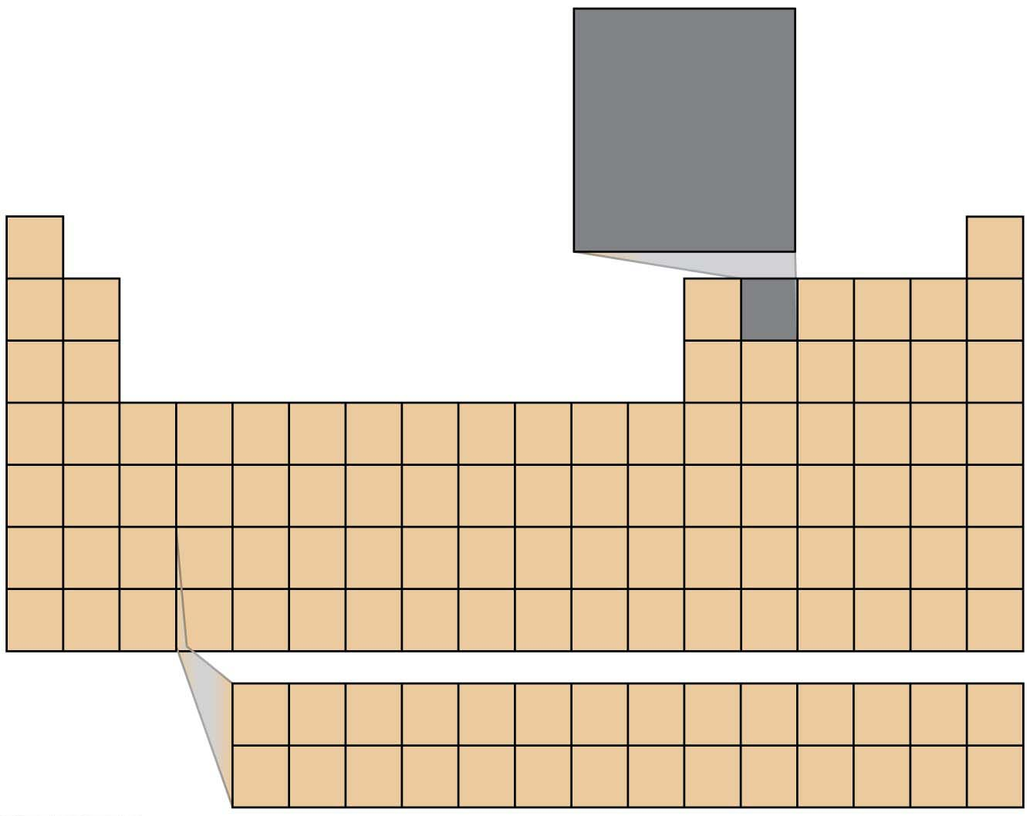
Figure 2.1-1
Atomic number
(number of protons)
6
C
Element symbol
Atomic mass
(mass of average
atom of that element)
12.01
H
He
Li
Be
B
C
N
O
F
Ne
Na
Mg
AI
Si
P
S
CI
Ar
K
Ca
Sc
Ti
V
Cr
Mn
Fe
Co
Ni
Cu
Zn
Ga
Ge
As
Se
Br
Kr
Rb
Sr
Y
Zr
Nb
Mo
Tc
Ru
Rh
Pd
Ag
Cd
In
Sn
Sb
Te
I
Xe
Cs
Ba
La
Hf
Ta
W
Re
Os
Ir
Pt
Au
Hg
TI
Pb
Bi
Po
At
Rn
Fr
Ra
Ac
Rf
Db
Sg
Bh
Hs
Mt
Ds
Rg
Cn
Ce
Pr
Nd
Pm
Sm
Eu
Gd
Tb
Dy
Ho
Er
Tm
Yb
Lu
Th
Pa
U
Np
Pu
Am
Cm
Bk
Cf
Es
Fm
Md
No
Lr
Notes:
Figure 2.1-1 Abbreviated periodic table of the elements

Slide 5
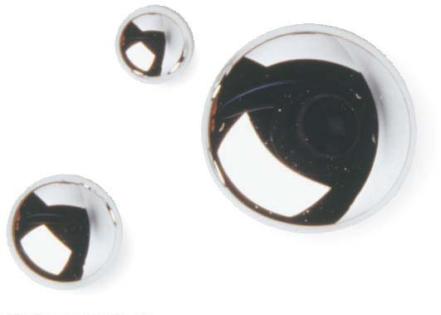
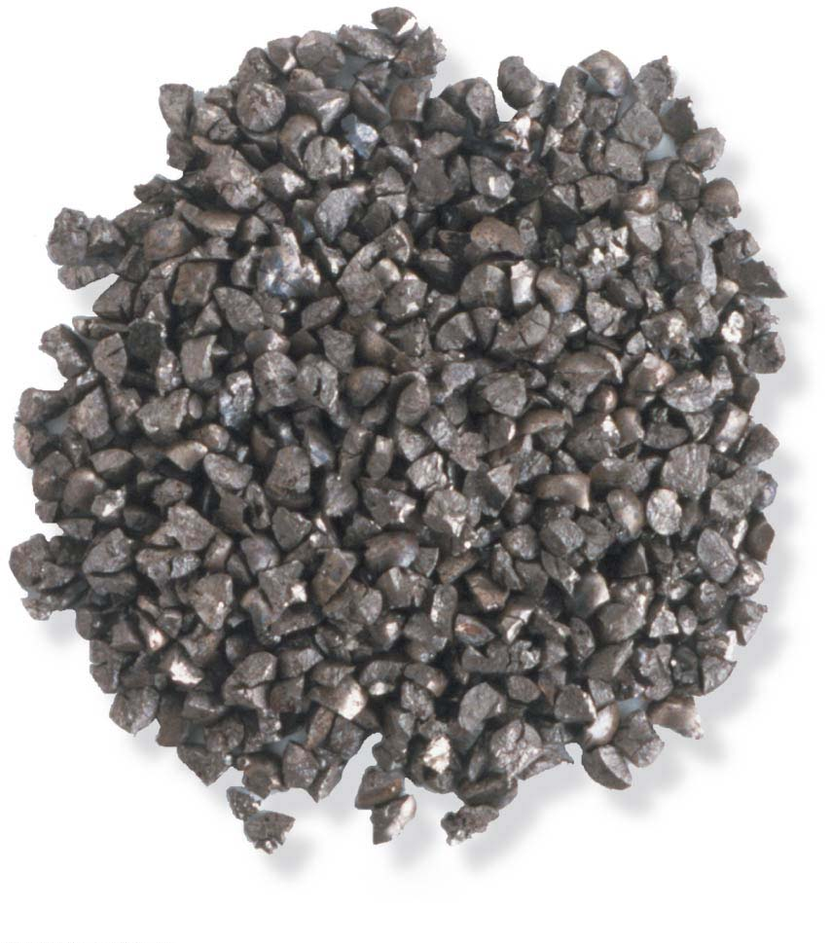
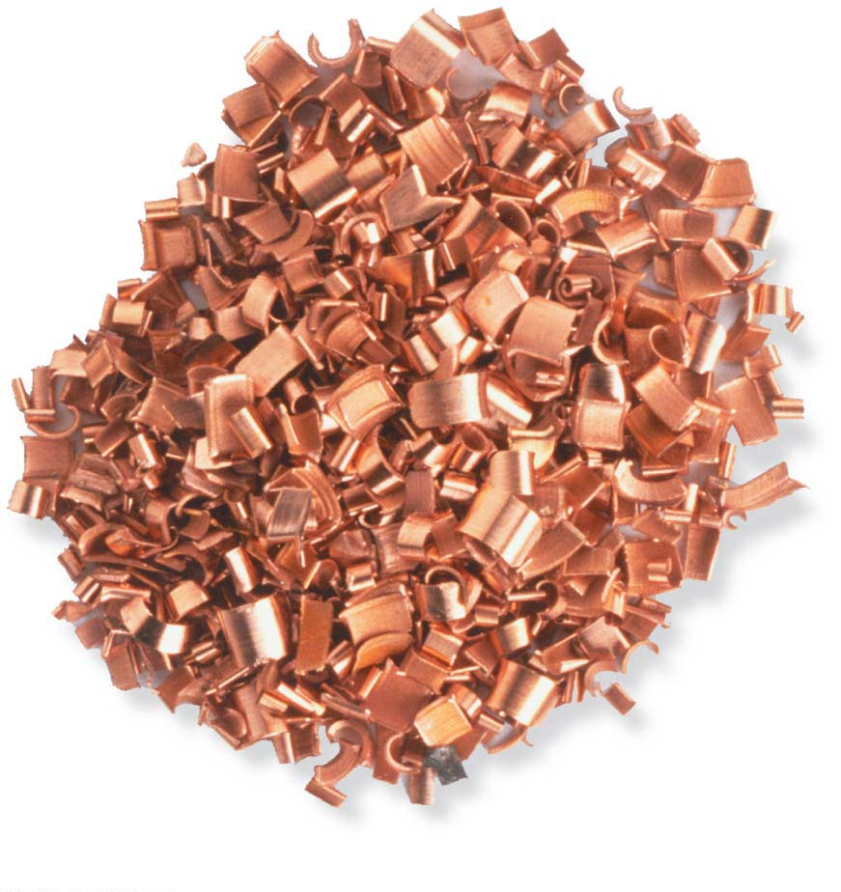
Figure 2.1-2
Mercury (Hg)
Lead (Pb)
Copper (Cu)
Notes:
Figure 2.1-2 Abbreviated periodic table of the elements (part 1: mercury)

Slide 6
Of the naturally occurring elements, 25 are essential to people.
Four of these elements make up about 96% of the weight of the body. Oxygen (O), carbon (C), hydrogen (H), and nitrogen (N).
Much of the remaining 4% is accounted for by 7 elements. These include the following.
Calcium, important for building strong bones and teeth, is found abundantly in dairy products, sardines정어리, and green, leafy vegetables.
Phosphorus, a component of DNA, can be obtained by eating eggs, beans, and nuts.
Notes:
6
Student Misconceptions and Concerns
1. The dangers posed by certain chemicals in our food and broader environment often mislead people to associate “chemicals” with harm. People might not want “chemicals” added to their food or present in their environment. Students often fail to appreciate the chemical nature of our bodies and our world and the potential harm or benefits of naturally occurring chemistry. They often fail to understand why “natural” does not necessarily mean “good.” (Consider presenting a long list of naturally occurring toxins to make this point.) Your class may benefit from a class discussion of these misconceptions about our attitudes toward “chemicals.”
2. Students with limited backgrounds in chemistry and physics might struggle with basic concepts of mass, weight, compounds, elements, and isotopes. It may also be early in the semester, when mature study habits have not yet developed. Consider passing along basic studying advice and tips to help students master these early chemistry concepts. In-class quizzes (graded or not) or a few homework problems will also provide reinforcing practice.
3. The half-lives of many radioactive substances, especially those used for dating fossils, might lead some students to expect very long periods of decay for any radioactive substance. This might even be alarming if students are someday asked to consume a radioactive substance for a medical test. However, some medically significant isotopes have relatively short half-lives. Radioactive iodine-131 is often used to diagnose or treat certain thyroid problems. Its half-life of 8 days means that it will decay quickly.
Teaching Tips
1. Students might be interested in the following aside: One of the challenges of raising captive, exotic animals is meeting the unique dietary requirements of the species. A zoo might have trouble keeping a particular animal because science has not fully determined what trace elements the animal requires.
2. Many breakfast cereals are fortified with iron. A person can crush the cereal and extract distinct iron particles with a magnet. An overhead projector or video imagining device should clearly reveal the iron particles stuck to the magnet. This short practical demonstration can help connect an abstract concept to a concrete example.
3. Students with limited backgrounds in chemistry will benefit from a discussion of Figure 2.7 and the differences and limitations of diagrams of atomic structures. The contrasts in Figure 2.7 are a good beginning of such a discussion.
4. Here is a comparison that helps make the point about the differences in mass of protons and electrons. If a proton is as massive as a bowling ball, an electron will be the mass of a Life Saver candy. (This is calculated by considering a 15-pound bowling ball, a Life Saver with a mass of 0.12 ounces, and the textbook’s formula that an electron is 1/2,000 the mass of a proton.)
5. Here is an analogy regarding the size of a helium atom. If a helium atom were the size of a major league baseball stadium, the nucleus would be about the size of a pea near the pitcher’s mound, and the two electrons would be like tiny gnats buzzing around the stadium. This analogy helps to relate the great distances between parts of an atom. Consider modifying the analogy to any local stadium in your region.
6. After sharing teaching tips 4 and 5 above, consider asking your students to compare the mass of the pea near the pitcher’s mound to the mass of one of the gnats orbiting the stadium. If a proton or neutron is about 2,000 times more massive than an electron, how does the mass of a helium nucleus compare to the mass of one of its electrons?
7. Have your students try to calculate the number of covalent bonds possible for a variety of atoms. Then provide the students with a list of elements and the number of outer electrons for each and have them make predictions about the chemical formula for many types of molecules.
8. Consider challenging your students to suggest relationships in human lives that are analogous to each of the three main types of chemical bonds (covalent, ionic, and hydrogen). Evaluating the accuracy of potential analogies requires careful analysis of the chemical bonding relationships and critical thinking skills. Small groups might provide immediate critiques before passing along analogies for the entire class to consider. The following is one example. Ionic and covalent bonds are different types of relationships. Consider this analogy. A woman taking out a loan has a specific relationship to her bank. She owes the bank money, something she got from the bank. A man shares an office with another man. Both look out the same window and answer the same phone. Ionic bonds are like a bank loan, in which something is borrowed. Covalent bonds are like sharing an office, with items (electrons) shared by both members of the relationship. After presenting this analogy, ask your students to modify the office analogy to represent a polar covalent bond. (Perhaps one man in the office sits closer to the window and the phone.)
9. As noted in the text, chemical reactions do not create or destroy matter. Instead, they rearrange the structure and form new relationships. This is much like shuffling and dealing cards. When playing poker, cards are not created nor destroyed. Instead, new combinations are formed as the cards are dealt to the players.
Active Lecture Tips
1. See the Essay Electrons and Ceiling Fans on the Instructor Exchange. Visit the Instructor Exchange in the MasteringBiology instructor resource area for a description of this activity.
2. See the Essay Relating Chemical Bonds to Everyday Ideas on the Instructor Exchange. Visit the Instructor Exchange in the MasteringBiology instructor resource area for a description of this activity.

Slide 7
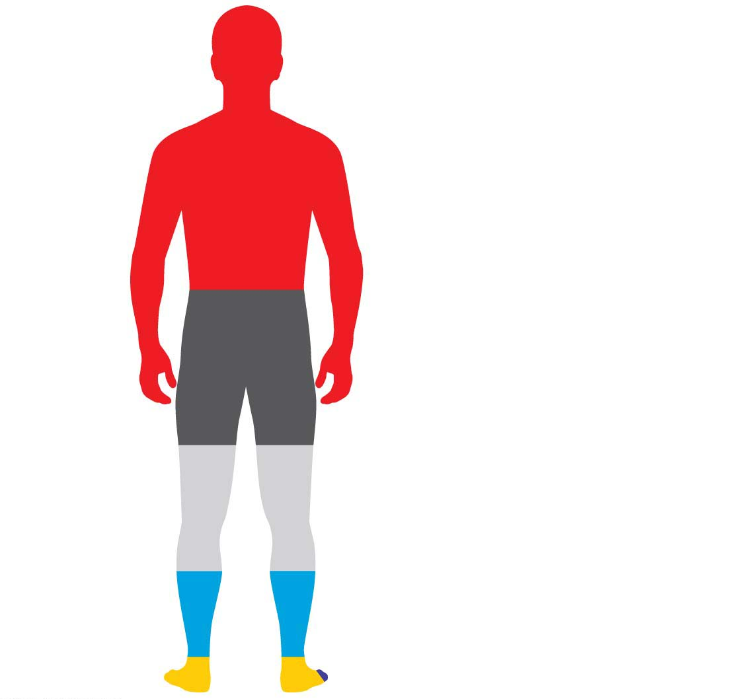
Figure 2.2
Carbon (C): 18.5%
Oxygen (O):
65.0%
Calcium (Ca): 1.5%
Phosphorus (P): 1.0%
Potassium (K): 0.4%
Sulfur (S): 0.3%
Sodium (Na): 0.2%
Chlorine (Cl): 0.2%
Hydrogen (H):
Magnesium (Mg): 0.1%
9.5%
Trace elements: less than 0.01%
Boron (B)
Manganese (Mn)
Nitrogen (N):
Chromium (Cr)
Molybdenum (Mo)
3.3%
Cobalt (Co)
Selenium (Se)
Copper (Cu)
Silicon (Si)
Fluorine (F)
Tin (Sn)
Iodine (I)
Vanadium (V)
Iron (Fe)
Zinc (Zn)
Notes:
Figure 2.2 Chemical composition of the human body

Slide 8
Atoms원자
Each element consists of one kind of atom.
An atom is the smallest unit of matter that still retains the properties of an element.
Atoms are composed of subatomic particles.
A proton양성자 is positively charged.
An electron전자 is negatively charged.
A neutron중성자 is electrically neutral.
Most atoms have protons and neutrons packed tightly into the nucleus.
The nucleus핵 is the atom’s central core.
Electrons move around the nucleus.
Notes:
8
Student Misconceptions and Concerns
1. The dangers posed by certain chemicals in our food and broader environment often mislead people to associate “chemicals” with harm. People might not want “chemicals” added to their food or present in their environment. Students often fail to appreciate the chemical nature of our bodies and our world and the potential harm or benefits of naturally occurring chemistry. They often fail to understand why “natural” does not necessarily mean “good.” (Consider presenting a long list of naturally occurring toxins to make this point.) Your class may benefit from a class discussion of these misconceptions about our attitudes toward “chemicals.”
2. Students with limited backgrounds in chemistry and physics might struggle with basic concepts of mass, weight, compounds, elements, and isotopes. It may also be early in the semester, when mature study habits have not yet developed. Consider passing along basic studying advice and tips to help students master these early chemistry concepts. In-class quizzes (graded or not) or a few homework problems will also provide reinforcing practice.
3. The half-lives of many radioactive substances, especially those used for dating fossils, might lead some students to expect very long periods of decay for any radioactive substance. This might even be alarming if students are someday asked to consume a radioactive substance for a medical test. However, some medically significant isotopes have relatively short half-lives. Radioactive iodine-131 is often used to diagnose or treat certain thyroid problems. Its half-life of 8 days means that it will decay quickly.
Teaching Tips
1. Students might be interested in the following aside: One of the challenges of raising captive, exotic animals is meeting the unique dietary requirements of the species. A zoo might have trouble keeping a particular animal because science has not fully determined what trace elements the animal requires.
2. Many breakfast cereals are fortified with iron. A person can crush the cereal and extract distinct iron particles with a magnet. An overhead projector or video imagining device should clearly reveal the iron particles stuck to the magnet. This short practical demonstration can help connect an abstract concept to a concrete example.
3. Students with limited backgrounds in chemistry will benefit from a discussion of Figure 2.7 and the differences and limitations of diagrams of atomic structures. The contrasts in Figure 2.7 are a good beginning of such a discussion.
4. Here is a comparison that helps make the point about the differences in mass of protons and electrons. If a proton is as massive as a bowling ball, an electron will be the mass of a Life Saver candy. (This is calculated by considering a 15-pound bowling ball, a Life Saver with a mass of 0.12 ounces, and the textbook’s formula that an electron is 1/2,000 the mass of a proton.)
5. Here is an analogy regarding the size of a helium atom. If a helium atom were the size of a major league baseball stadium, the nucleus would be about the size of a pea near the pitcher’s mound, and the two electrons would be like tiny gnats buzzing around the stadium. This analogy helps to relate the great distances between parts of an atom. Consider modifying the analogy to any local stadium in your region.
6. After sharing teaching tips 4 and 5 above, consider asking your students to compare the mass of the pea near the pitcher’s mound to the mass of one of the gnats orbiting the stadium. If a proton or neutron is about 2,000 times more massive than an electron, how does the mass of a helium nucleus compare to the mass of one of its electrons?
7. Have your students try to calculate the number of covalent bonds possible for a variety of atoms. Then provide the students with a list of elements and the number of outer electrons for each and have them make predictions about the chemical formula for many types of molecules.
8. Consider challenging your students to suggest relationships in human lives that are analogous to each of the three main types of chemical bonds (covalent, ionic, and hydrogen). Evaluating the accuracy of potential analogies requires careful analysis of the chemical bonding relationships and critical thinking skills. Small groups might provide immediate critiques before passing along analogies for the entire class to consider. The following is one example. Ionic and covalent bonds are different types of relationships. Consider this analogy. A woman taking out a loan has a specific relationship to her bank. She owes the bank money, something she got from the bank. A man shares an office with another man. Both look out the same window and answer the same phone. Ionic bonds are like a bank loan, in which something is borrowed. Covalent bonds are like sharing an office, with items (electrons) shared by both members of the relationship. After presenting this analogy, ask your students to modify the office analogy to represent a polar covalent bond. (Perhaps one man in the office sits closer to the window and the phone.)
9. As noted in the text, chemical reactions do not create or destroy matter. Instead, they rearrange the structure and form new relationships. This is much like shuffling and dealing cards. When playing poker, cards are not created nor destroyed. Instead, new combinations are formed as the cards are dealt to the players.
Active Lecture Tips
1. See the Essay Electrons and Ceiling Fans on the Instructor Exchange. Visit the Instructor Exchange in the MasteringBiology instructor resource area for a description of this activity.
2. See the Essay Relating Chemical Bonds to Everyday Ideas on the Instructor Exchange. Visit the Instructor Exchange in the MasteringBiology instructor resource area for a description of this activity.

Slide 9
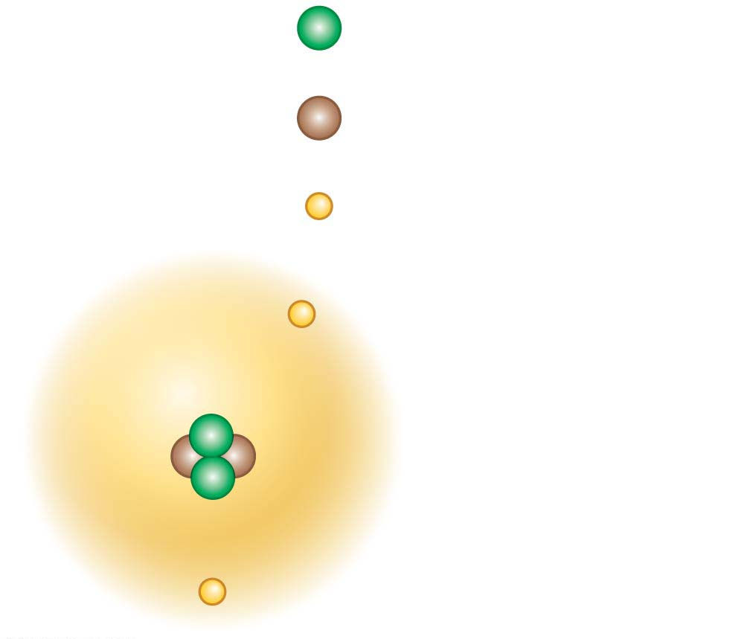
Figure 2.4
He (helium)
2
+
Protons
Nucleus
2
Neutrons
Nucleus
2
−
Electrons
−
Electron cloud
containing two
electrons
+
+
−
Notes:
Figure 2.4 A simplified model of a helium atom

Slide 10
All atoms of a particular element have the same unique number of protons.
This number is the element’s atomic number 원자번호.
Thus, an atom of helium, with 2 protons, has an atomic number of 2, and no other element has 2 protons.
An atom’s mass number질량수 is the sum of the number of protons and neutrons in its nucleus.
An atom’s atomic mass원자질량
is close to its mass number, the sum of its protons and neutrons,
but may differ slightly because it represents an average of all the naturally occurring forms of that element.
Notes:
10
Student Misconceptions and Concerns
1. The dangers posed by certain chemicals in our food and broader environment often mislead people to associate “chemicals” with harm. People might not want “chemicals” added to their food or present in their environment. Students often fail to appreciate the chemical nature of our bodies and our world and the potential harm or benefits of naturally occurring chemistry. They often fail to understand why “natural” does not necessarily mean “good.” (Consider presenting a long list of naturally occurring toxins to make this point.) Your class may benefit from a class discussion of these misconceptions about our attitudes toward “chemicals.”
2. Students with limited backgrounds in chemistry and physics might struggle with basic concepts of mass, weight, compounds, elements, and isotopes. It may also be early in the semester, when mature study habits have not yet developed. Consider passing along basic studying advice and tips to help students master these early chemistry concepts. In-class quizzes (graded or not) or a few homework problems will also provide reinforcing practice.
3. The half-lives of many radioactive substances, especially those used for dating fossils, might lead some students to expect very long periods of decay for any radioactive substance. This might even be alarming if students are someday asked to consume a radioactive substance for a medical test. However, some medically significant isotopes have relatively short half-lives. Radioactive iodine-131 is often used to diagnose or treat certain thyroid problems. Its half-life of 8 days means that it will decay quickly.
Teaching Tips
1. Students might be interested in the following aside: One of the challenges of raising captive, exotic animals is meeting the unique dietary requirements of the species. A zoo might have trouble keeping a particular animal because science has not fully determined what trace elements the animal requires.
2. Many breakfast cereals are fortified with iron. A person can crush the cereal and extract distinct iron particles with a magnet. An overhead projector or video imagining device should clearly reveal the iron particles stuck to the magnet. This short practical demonstration can help connect an abstract concept to a concrete example.
3. Students with limited backgrounds in chemistry will benefit from a discussion of Figure 2.7 and the differences and limitations of diagrams of atomic structures. The contrasts in Figure 2.7 are a good beginning of such a discussion.
4. Here is a comparison that helps make the point about the differences in mass of protons and electrons. If a proton is as massive as a bowling ball, an electron will be the mass of a Life Saver candy. (This is calculated by considering a 15-pound bowling ball, a Life Saver with a mass of 0.12 ounces, and the textbook’s formula that an electron is 1/2,000 the mass of a proton.)
5. Here is an analogy regarding the size of a helium atom. If a helium atom were the size of a major league baseball stadium, the nucleus would be about the size of a pea near the pitcher’s mound, and the two electrons would be like tiny gnats buzzing around the stadium. This analogy helps to relate the great distances between parts of an atom. Consider modifying the analogy to any local stadium in your region.
6. After sharing teaching tips 4 and 5 above, consider asking your students to compare the mass of the pea near the pitcher’s mound to the mass of one of the gnats orbiting the stadium. If a proton or neutron is about 2,000 times more massive than an electron, how does the mass of a helium nucleus compare to the mass of one of its electrons?
7. Have your students try to calculate the number of covalent bonds possible for a variety of atoms. Then provide the students with a list of elements and the number of outer electrons for each and have them make predictions about the chemical formula for many types of molecules.
8. Consider challenging your students to suggest relationships in human lives that are analogous to each of the three main types of chemical bonds (covalent, ionic, and hydrogen). Evaluating the accuracy of potential analogies requires careful analysis of the chemical bonding relationships and critical thinking skills. Small groups might provide immediate critiques before passing along analogies for the entire class to consider. The following is one example. Ionic and covalent bonds are different types of relationships. Consider this analogy. A woman taking out a loan has a specific relationship to her bank. She owes the bank money, something she got from the bank. A man shares an office with another man. Both look out the same window and answer the same phone. Ionic bonds are like a bank loan, in which something is borrowed. Covalent bonds are like sharing an office, with items (electrons) shared by both members of the relationship. After presenting this analogy, ask your students to modify the office analogy to represent a polar covalent bond. (Perhaps one man in the office sits closer to the window and the phone.)
9. As noted in the text, chemical reactions do not create or destroy matter. Instead, they rearrange the structure and form new relationships. This is much like shuffling and dealing cards. When playing poker, cards are not created nor destroyed. Instead, new combinations are formed as the cards are dealt to the players.
Active Lecture Tips
1. See the Essay Electrons and Ceiling Fans on the Instructor Exchange. Visit the Instructor Exchange in the MasteringBiology instructor resource area for a description of this activity.
2. See the Essay Relating Chemical Bonds to Everyday Ideas on the Instructor Exchange. Visit the Instructor Exchange in the MasteringBiology instructor resource area for a description of this activity.

Slide 11
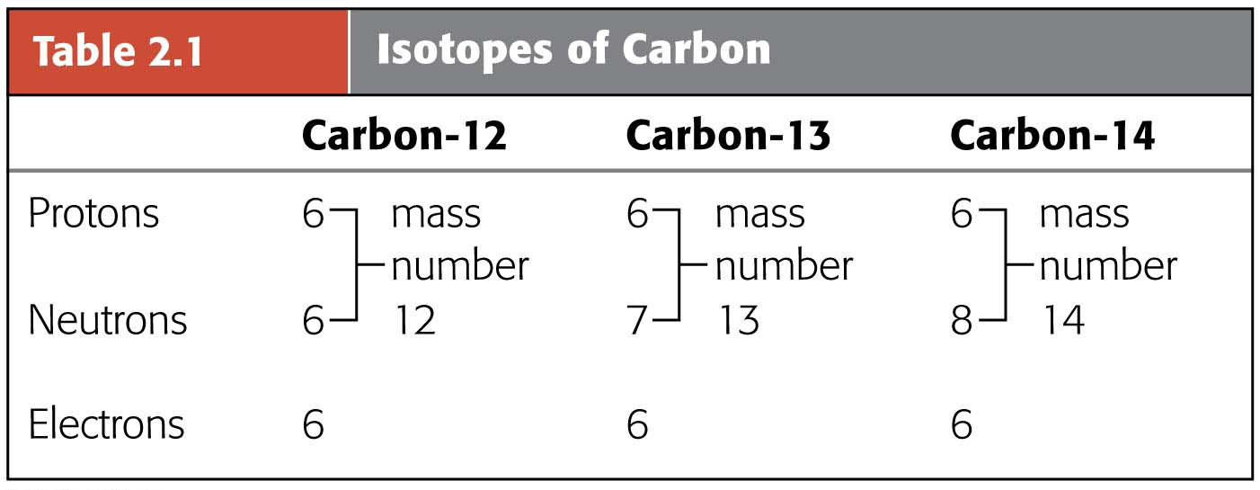
Isotopes동위원소
Isotopes are alternate mass forms of an element.
Isotopes
have the same number of protons and electrons but
differ in their number of neutrons.
Notes:
11
Student Misconceptions and Concerns
1. The dangers posed by certain chemicals in our food and broader environment often mislead people to associate “chemicals” with harm. People might not want “chemicals” added to their food or present in their environment. Students often fail to appreciate the chemical nature of our bodies and our world and the potential harm or benefits of naturally occurring chemistry. They often fail to understand why “natural” does not necessarily mean “good.” (Consider presenting a long list of naturally occurring toxins to make this point.) Your class may benefit from a class discussion of these misconceptions about our attitudes toward “chemicals.”
2. Students with limited backgrounds in chemistry and physics might struggle with basic concepts of mass, weight, compounds, elements, and isotopes. It may also be early in the semester, when mature study habits have not yet developed. Consider passing along basic studying advice and tips to help students master these early chemistry concepts. In-class quizzes (graded or not) or a few homework problems will also provide reinforcing practice.
3. The half-lives of many radioactive substances, especially those used for dating fossils, might lead some students to expect very long periods of decay for any radioactive substance. This might even be alarming if students are someday asked to consume a radioactive substance for a medical test. However, some medically significant isotopes have relatively short half-lives. Radioactive iodine-131 is often used to diagnose or treat certain thyroid problems. Its half-life of 8 days means that it will decay quickly.
Teaching Tips
1. Students might be interested in the following aside: One of the challenges of raising captive, exotic animals is meeting the unique dietary requirements of the species. A zoo might have trouble keeping a particular animal because science has not fully determined what trace elements the animal requires.
2. Many breakfast cereals are fortified with iron. A person can crush the cereal and extract distinct iron particles with a magnet. An overhead projector or video imagining device should clearly reveal the iron particles stuck to the magnet. This short practical demonstration can help connect an abstract concept to a concrete example.
3. Students with limited backgrounds in chemistry will benefit from a discussion of Figure 2.7 and the differences and limitations of diagrams of atomic structures. The contrasts in Figure 2.7 are a good beginning of such a discussion.
4. Here is a comparison that helps make the point about the differences in mass of protons and electrons. If a proton is as massive as a bowling ball, an electron will be the mass of a Life Saver candy. (This is calculated by considering a 15-pound bowling ball, a Life Saver with a mass of 0.12 ounces, and the textbook’s formula that an electron is 1/2,000 the mass of a proton.)
5. Here is an analogy regarding the size of a helium atom. If a helium atom were the size of a major league baseball stadium, the nucleus would be about the size of a pea near the pitcher’s mound, and the two electrons would be like tiny gnats buzzing around the stadium. This analogy helps to relate the great distances between parts of an atom. Consider modifying the analogy to any local stadium in your region.
6. After sharing teaching tips 4 and 5 above, consider asking your students to compare the mass of the pea near the pitcher’s mound to the mass of one of the gnats orbiting the stadium. If a proton or neutron is about 2,000 times more massive than an electron, how does the mass of a helium nucleus compare to the mass of one of its electrons?
7. Have your students try to calculate the number of covalent bonds possible for a variety of atoms. Then provide the students with a list of elements and the number of outer electrons for each and have them make predictions about the chemical formula for many types of molecules.
8. Consider challenging your students to suggest relationships in human lives that are analogous to each of the three main types of chemical bonds (covalent, ionic, and hydrogen). Evaluating the accuracy of potential analogies requires careful analysis of the chemical bonding relationships and critical thinking skills. Small groups might provide immediate critiques before passing along analogies for the entire class to consider. The following is one example. Ionic and covalent bonds are different types of relationships. Consider this analogy. A woman taking out a loan has a specific relationship to her bank. She owes the bank money, something she got from the bank. A man shares an office with another man. Both look out the same window and answer the same phone. Ionic bonds are like a bank loan, in which something is borrowed. Covalent bonds are like sharing an office, with items (electrons) shared by both members of the relationship. After presenting this analogy, ask your students to modify the office analogy to represent a polar covalent bond. (Perhaps one man in the office sits closer to the window and the phone.)
9. As noted in the text, chemical reactions do not create or destroy matter. Instead, they rearrange the structure and form new relationships. This is much like shuffling and dealing cards. When playing poker, cards are not created nor destroyed. Instead, new combinations are formed as the cards are dealt to the players.
Active Lecture Tips
1. See the Essay Electrons and Ceiling Fans on the Instructor Exchange. Visit the Instructor Exchange in the MasteringBiology instructor resource area for a description of this activity.
2. See the Essay Relating Chemical Bonds to Everyday Ideas on the Instructor Exchange. Visit the Instructor Exchange in the MasteringBiology instructor resource area for a description of this activity.

Slide 12
A radioactive isotope방사성 동위원소 is one in which the nucleus decays spontaneously.
Radiation from decaying isotopes can
damage cellular molecules and
pose serious health risks.
Cells use radioactive isotopes the same way they use nonradioactive isotopes of the same element.
Once the cell takes up a radioactive isotope, the location and concentration of the isotope can be detected because of the radiation it emits.
Notes:
12
Student Misconceptions and Concerns
1. The dangers posed by certain chemicals in our food and broader environment often mislead people to associate “chemicals” with harm. People might not want “chemicals” added to their food or present in their environment. Students often fail to appreciate the chemical nature of our bodies and our world and the potential harm or benefits of naturally occurring chemistry. They often fail to understand why “natural” does not necessarily mean “good.” (Consider presenting a long list of naturally occurring toxins to make this point.) Your class may benefit from a class discussion of these misconceptions about our attitudes toward “chemicals.”
2. Students with limited backgrounds in chemistry and physics might struggle with basic concepts of mass, weight, compounds, elements, and isotopes. It may also be early in the semester, when mature study habits have not yet developed. Consider passing along basic studying advice and tips to help students master these early chemistry concepts. In-class quizzes (graded or not) or a few homework problems will also provide reinforcing practice.
3. The half-lives of many radioactive substances, especially those used for dating fossils, might lead some students to expect very long periods of decay for any radioactive substance. This might even be alarming if students are someday asked to consume a radioactive substance for a medical test. However, some medically significant isotopes have relatively short half-lives. Radioactive iodine-131 is often used to diagnose or treat certain thyroid problems. Its half-life of 8 days means that it will decay quickly.
Teaching Tips
1. Students might be interested in the following aside: One of the challenges of raising captive, exotic animals is meeting the unique dietary requirements of the species. A zoo might have trouble keeping a particular animal because science has not fully determined what trace elements the animal requires.
2. Many breakfast cereals are fortified with iron. A person can crush the cereal and extract distinct iron particles with a magnet. An overhead projector or video imagining device should clearly reveal the iron particles stuck to the magnet. This short practical demonstration can help connect an abstract concept to a concrete example.
3. Students with limited backgrounds in chemistry will benefit from a discussion of Figure 2.7 and the differences and limitations of diagrams of atomic structures. The contrasts in Figure 2.7 are a good beginning of such a discussion.
4. Here is a comparison that helps make the point about the differences in mass of protons and electrons. If a proton is as massive as a bowling ball, an electron will be the mass of a Life Saver candy. (This is calculated by considering a 15-pound bowling ball, a Life Saver with a mass of 0.12 ounces, and the textbook’s formula that an electron is 1/2,000 the mass of a proton.)
5. Here is an analogy regarding the size of a helium atom. If a helium atom were the size of a major league baseball stadium, the nucleus would be about the size of a pea near the pitcher’s mound, and the two electrons would be like tiny gnats buzzing around the stadium. This analogy helps to relate the great distances between parts of an atom. Consider modifying the analogy to any local stadium in your region.
6. After sharing teaching tips 4 and 5 above, consider asking your students to compare the mass of the pea near the pitcher’s mound to the mass of one of the gnats orbiting the stadium. If a proton or neutron is about 2,000 times more massive than an electron, how does the mass of a helium nucleus compare to the mass of one of its electrons?
7. Have your students try to calculate the number of covalent bonds possible for a variety of atoms. Then provide the students with a list of elements and the number of outer electrons for each and have them make predictions about the chemical formula for many types of molecules.
8. Consider challenging your students to suggest relationships in human lives that are analogous to each of the three main types of chemical bonds (covalent, ionic, and hydrogen). Evaluating the accuracy of potential analogies requires careful analysis of the chemical bonding relationships and critical thinking skills. Small groups might provide immediate critiques before passing along analogies for the entire class to consider. The following is one example. Ionic and covalent bonds are different types of relationships. Consider this analogy. A woman taking out a loan has a specific relationship to her bank. She owes the bank money, something she got from the bank. A man shares an office with another man. Both look out the same window and answer the same phone. Ionic bonds are like a bank loan, in which something is borrowed. Covalent bonds are like sharing an office, with items (electrons) shared by both members of the relationship. After presenting this analogy, ask your students to modify the office analogy to represent a polar covalent bond. (Perhaps one man in the office sits closer to the window and the phone.)
9. As noted in the text, chemical reactions do not create or destroy matter. Instead, they rearrange the structure and form new relationships. This is much like shuffling and dealing cards. When playing poker, cards are not created nor destroyed. Instead, new combinations are formed as the cards are dealt to the players.
Active Lecture Tips
1. See the Essay Electrons and Ceiling Fans on the Instructor Exchange. Visit the Instructor Exchange in the MasteringBiology instructor resource area for a description of this activity.
2. See the Essay Relating Chemical Bonds to Everyday Ideas on the Instructor Exchange. Visit the Instructor Exchange in the MasteringBiology instructor resource area for a description of this activity.

Slide 13
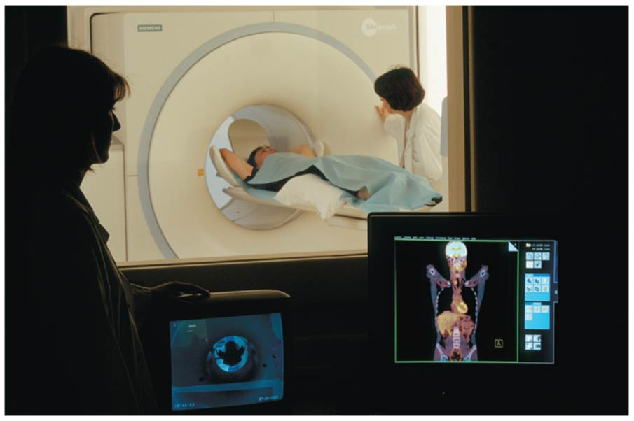
The Process of Science: Can Radioactive Tracers Identify Brain Diseases?
In 2012, researchers from a U.S. pharmaceutical company announced the results of a study that used PET (positron emission tomography) scans to investigate Alzheimer’s disease.
The observation that the brains of people with Alzheimer’s are often filled with clumps of a protein called amyloid led the researchers to question whether these clumps could be detected by a PET scan.
Notes:
13
Student Misconceptions and Concerns
1. The dangers posed by certain chemicals in our food and broader environment often mislead people to associate “chemicals” with harm. People might not want “chemicals” added to their food or present in their environment. Students often fail to appreciate the chemical nature of our bodies and our world and the potential harm or benefits of naturally occurring chemistry. They often fail to understand why “natural” does not necessarily mean “good.” (Consider presenting a long list of naturally occurring toxins to make this point.) Your class may benefit from a class discussion of these misconceptions about our attitudes toward “chemicals.”
2. Students with limited backgrounds in chemistry and physics might struggle with basic concepts of mass, weight, compounds, elements, and isotopes. It may also be early in the semester, when mature study habits have not yet developed. Consider passing along basic studying advice and tips to help students master these early chemistry concepts. In-class quizzes (graded or not) or a few homework problems will also provide reinforcing practice.
3. The half-lives of many radioactive substances, especially those used for dating fossils, might lead some students to expect very long periods of decay for any radioactive substance. This might even be alarming if students are someday asked to consume a radioactive substance for a medical test. However, some medically significant isotopes have relatively short half-lives. Radioactive iodine-131 is often used to diagnose or treat certain thyroid problems. Its half-life of 8 days means that it will decay quickly.
Teaching Tips
1. Students might be interested in the following aside: One of the challenges of raising captive, exotic animals is meeting the unique dietary requirements of the species. A zoo might have trouble keeping a particular animal because science has not fully determined what trace elements the animal requires.
2. Many breakfast cereals are fortified with iron. A person can crush the cereal and extract distinct iron particles with a magnet. An overhead projector or video imagining device should clearly reveal the iron particles stuck to the magnet. This short practical demonstration can help connect an abstract concept to a concrete example.
3. Students with limited backgrounds in chemistry will benefit from a discussion of Figure 2.7 and the differences and limitations of diagrams of atomic structures. The contrasts in Figure 2.7 are a good beginning of such a discussion.
4. Here is a comparison that helps make the point about the differences in mass of protons and electrons. If a proton is as massive as a bowling ball, an electron will be the mass of a Life Saver candy. (This is calculated by considering a 15-pound bowling ball, a Life Saver with a mass of 0.12 ounces, and the textbook’s formula that an electron is 1/2,000 the mass of a proton.)
5. Here is an analogy regarding the size of a helium atom. If a helium atom were the size of a major league baseball stadium, the nucleus would be about the size of a pea near the pitcher’s mound, and the two electrons would be like tiny gnats buzzing around the stadium. This analogy helps to relate the great distances between parts of an atom. Consider modifying the analogy to any local stadium in your region.
6. After sharing teaching tips 4 and 5 above, consider asking your students to compare the mass of the pea near the pitcher’s mound to the mass of one of the gnats orbiting the stadium. If a proton or neutron is about 2,000 times more massive than an electron, how does the mass of a helium nucleus compare to the mass of one of its electrons?
7. Have your students try to calculate the number of covalent bonds possible for a variety of atoms. Then provide the students with a list of elements and the number of outer electrons for each and have them make predictions about the chemical formula for many types of molecules.
8. Consider challenging your students to suggest relationships in human lives that are analogous to each of the three main types of chemical bonds (covalent, ionic, and hydrogen). Evaluating the accuracy of potential analogies requires careful analysis of the chemical bonding relationships and critical thinking skills. Small groups might provide immediate critiques before passing along analogies for the entire class to consider. The following is one example. Ionic and covalent bonds are different types of relationships. Consider this analogy. A woman taking out a loan has a specific relationship to her bank. She owes the bank money, something she got from the bank. A man shares an office with another man. Both look out the same window and answer the same phone. Ionic bonds are like a bank loan, in which something is borrowed. Covalent bonds are like sharing an office, with items (electrons) shared by both members of the relationship. After presenting this analogy, ask your students to modify the office analogy to represent a polar covalent bond. (Perhaps one man in the office sits closer to the window and the phone.)
9. As noted in the text, chemical reactions do not create or destroy matter. Instead, they rearrange the structure and form new relationships. This is much like shuffling and dealing cards. When playing poker, cards are not created nor destroyed. Instead, new combinations are formed as the cards are dealt to the players.
Active Lecture Tips
1. See the Essay Electrons and Ceiling Fans on the Instructor Exchange. Visit the Instructor Exchange in the MasteringBiology instructor resource area for a description of this activity.
2. See the Essay Relating Chemical Bonds to Everyday Ideas on the Instructor Exchange. Visit the Instructor Exchange in the MasteringBiology instructor resource area for a description of this activity.

Slide 14
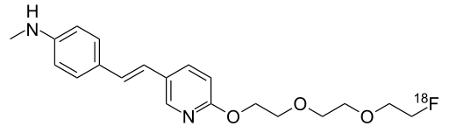
The researchers formed the hypothesis가설 that a molecule called florbetapir, which contains the radioactive isotope fluorine-18, could be detected by PET scans after it binds to amyloid deposits in living patients.
Their experiment involved using the radioactive isotope and PET scans to test 229 patients who had been diagnosed with mental decline.
The results indicated that 113 patients showed amyloid deposits in their PET scans. As a result,
doctors changed the diagnosis in 55% of the patients.
Notes:
14
Student Misconceptions and Concerns
1. The dangers posed by certain chemicals in our food and broader environment often mislead people to associate “chemicals” with harm. People might not want “chemicals” added to their food or present in their environment. Students often fail to appreciate the chemical nature of our bodies and our world and the potential harm or benefits of naturally occurring chemistry. They often fail to understand why “natural” does not necessarily mean “good.” (Consider presenting a long list of naturally occurring toxins to make this point.) Your class may benefit from a class discussion of these misconceptions about our attitudes toward “chemicals.”
2. Students with limited backgrounds in chemistry and physics might struggle with basic concepts of mass, weight, compounds, elements, and isotopes. It may also be early in the semester, when mature study habits have not yet developed. Consider passing along basic studying advice and tips to help students master these early chemistry concepts. In-class quizzes (graded or not) or a few homework problems will also provide reinforcing practice.
3. The half-lives of many radioactive substances, especially those used for dating fossils, might lead some students to expect very long periods of decay for any radioactive substance. This might even be alarming if students are someday asked to consume a radioactive substance for a medical test. However, some medically significant isotopes have relatively short half-lives. Radioactive iodine-131 is often used to diagnose or treat certain thyroid problems. Its half-life of 8 days means that it will decay quickly.
Teaching Tips
1. Students might be interested in the following aside: One of the challenges of raising captive, exotic animals is meeting the unique dietary requirements of the species. A zoo might have trouble keeping a particular animal because science has not fully determined what trace elements the animal requires.
2. Many breakfast cereals are fortified with iron. A person can crush the cereal and extract distinct iron particles with a magnet. An overhead projector or video imagining device should clearly reveal the iron particles stuck to the magnet. This short practical demonstration can help connect an abstract concept to a concrete example.
3. Students with limited backgrounds in chemistry will benefit from a discussion of Figure 2.7 and the differences and limitations of diagrams of atomic structures. The contrasts in Figure 2.7 are a good beginning of such a discussion.
4. Here is a comparison that helps make the point about the differences in mass of protons and electrons. If a proton is as massive as a bowling ball, an electron will be the mass of a Life Saver candy. (This is calculated by considering a 15-pound bowling ball, a Life Saver with a mass of 0.12 ounces, and the textbook’s formula that an electron is 1/2,000 the mass of a proton.)
5. Here is an analogy regarding the size of a helium atom. If a helium atom were the size of a major league baseball stadium, the nucleus would be about the size of a pea near the pitcher’s mound, and the two electrons would be like tiny gnats buzzing around the stadium. This analogy helps to relate the great distances between parts of an atom. Consider modifying the analogy to any local stadium in your region.
6. After sharing teaching tips 4 and 5 above, consider asking your students to compare the mass of the pea near the pitcher’s mound to the mass of one of the gnats orbiting the stadium. If a proton or neutron is about 2,000 times more massive than an electron, how does the mass of a helium nucleus compare to the mass of one of its electrons?
7. Have your students try to calculate the number of covalent bonds possible for a variety of atoms. Then provide the students with a list of elements and the number of outer electrons for each and have them make predictions about the chemical formula for many types of molecules.
8. Consider challenging your students to suggest relationships in human lives that are analogous to each of the three main types of chemical bonds (covalent, ionic, and hydrogen). Evaluating the accuracy of potential analogies requires careful analysis of the chemical bonding relationships and critical thinking skills. Small groups might provide immediate critiques before passing along analogies for the entire class to consider. The following is one example. Ionic and covalent bonds are different types of relationships. Consider this analogy. A woman taking out a loan has a specific relationship to her bank. She owes the bank money, something she got from the bank. A man shares an office with another man. Both look out the same window and answer the same phone. Ionic bonds are like a bank loan, in which something is borrowed. Covalent bonds are like sharing an office, with items (electrons) shared by both members of the relationship. After presenting this analogy, ask your students to modify the office analogy to represent a polar covalent bond. (Perhaps one man in the office sits closer to the window and the phone.)
9. As noted in the text, chemical reactions do not create or destroy matter. Instead, they rearrange the structure and form new relationships. This is much like shuffling and dealing cards. When playing poker, cards are not created nor destroyed. Instead, new combinations are formed as the cards are dealt to the players.
Active Lecture Tips
1. See the Essay Electrons and Ceiling Fans on the Instructor Exchange. Visit the Instructor Exchange in the MasteringBiology instructor resource area for a description of this activity.
2. See the Essay Relating Chemical Bonds to Everyday Ideas on the Instructor Exchange. Visit the Instructor Exchange in the MasteringBiology instructor resource area for a description of this activity.

Slide 15
Chemical Bonding and Molecules
Only electrons are directly involved in chemical reactions.
The number of electrons in an atom determines the chemical properties of that atom.
Chemical reactions enable atoms to transfer or share electrons.
These interactions usually result in atoms staying close together, held by attractions called chemical bonds화학결합.
Notes:
15
Student Misconceptions and Concerns
1. The dangers posed by certain chemicals in our food and broader environment often mislead people to associate “chemicals” with harm. People might not want “chemicals” added to their food or present in their environment. Students often fail to appreciate the chemical nature of our bodies and our world and the potential harm or benefits of naturally occurring chemistry. They often fail to understand why “natural” does not necessarily mean “good.” (Consider presenting a long list of naturally occurring toxins to make this point.) Your class may benefit from a class discussion of these misconceptions about our attitudes toward “chemicals.”
2. Students with limited backgrounds in chemistry and physics might struggle with basic concepts of mass, weight, compounds, elements, and isotopes. It may also be early in the semester, when mature study habits have not yet developed. Consider passing along basic studying advice and tips to help students master these early chemistry concepts. In-class quizzes (graded or not) or a few homework problems will also provide reinforcing practice.
3. The half-lives of many radioactive substances, especially those used for dating fossils, might lead some students to expect very long periods of decay for any radioactive substance. This might even be alarming if students are someday asked to consume a radioactive substance for a medical test. However, some medically significant isotopes have relatively short half-lives. Radioactive iodine-131 is often used to diagnose or treat certain thyroid problems. Its half-life of 8 days means that it will decay quickly.
Teaching Tips
1. Students might be interested in the following aside: One of the challenges of raising captive, exotic animals is meeting the unique dietary requirements of the species. A zoo might have trouble keeping a particular animal because science has not fully determined what trace elements the animal requires.
2. Many breakfast cereals are fortified with iron. A person can crush the cereal and extract distinct iron particles with a magnet. An overhead projector or video imagining device should clearly reveal the iron particles stuck to the magnet. This short practical demonstration can help connect an abstract concept to a concrete example.
3. Students with limited backgrounds in chemistry will benefit from a discussion of Figure 2.7 and the differences and limitations of diagrams of atomic structures. The contrasts in Figure 2.7 are a good beginning of such a discussion.
4. Here is a comparison that helps make the point about the differences in mass of protons and electrons. If a proton is as massive as a bowling ball, an electron will be the mass of a Life Saver candy. (This is calculated by considering a 15-pound bowling ball, a Life Saver with a mass of 0.12 ounces, and the textbook’s formula that an electron is 1/2,000 the mass of a proton.)
5. Here is an analogy regarding the size of a helium atom. If a helium atom were the size of a major league baseball stadium, the nucleus would be about the size of a pea near the pitcher’s mound, and the two electrons would be like tiny gnats buzzing around the stadium. This analogy helps to relate the great distances between parts of an atom. Consider modifying the analogy to any local stadium in your region.
6. After sharing teaching tips 4 and 5 above, consider asking your students to compare the mass of the pea near the pitcher’s mound to the mass of one of the gnats orbiting the stadium. If a proton or neutron is about 2,000 times more massive than an electron, how does the mass of a helium nucleus compare to the mass of one of its electrons?
7. Have your students try to calculate the number of covalent bonds possible for a variety of atoms. Then provide the students with a list of elements and the number of outer electrons for each and have them make predictions about the chemical formula for many types of molecules.
8. Consider challenging your students to suggest relationships in human lives that are analogous to each of the three main types of chemical bonds (covalent, ionic, and hydrogen). Evaluating the accuracy of potential analogies requires careful analysis of the chemical bonding relationships and critical thinking skills. Small groups might provide immediate critiques before passing along analogies for the entire class to consider. The following is one example. Ionic and covalent bonds are different types of relationships. Consider this analogy. A woman taking out a loan has a specific relationship to her bank. She owes the bank money, something she got from the bank. A man shares an office with another man. Both look out the same window and answer the same phone. Ionic bonds are like a bank loan, in which something is borrowed. Covalent bonds are like sharing an office, with items (electrons) shared by both members of the relationship. After presenting this analogy, ask your students to modify the office analogy to represent a polar covalent bond. (Perhaps one man in the office sits closer to the window and the phone.)
9. As noted in the text, chemical reactions do not create or destroy matter. Instead, they rearrange the structure and form new relationships. This is much like shuffling and dealing cards. When playing poker, cards are not created nor destroyed. Instead, new combinations are formed as the cards are dealt to the players.
Active Lecture Tips
1. See the Essay Electrons and Ceiling Fans on the Instructor Exchange. Visit the Instructor Exchange in the MasteringBiology instructor resource area for a description of this activity.
2. See the Essay Relating Chemical Bonds to Everyday Ideas on the Instructor Exchange. Visit the Instructor Exchange in the MasteringBiology instructor resource area for a description of this activity.

Slide 16
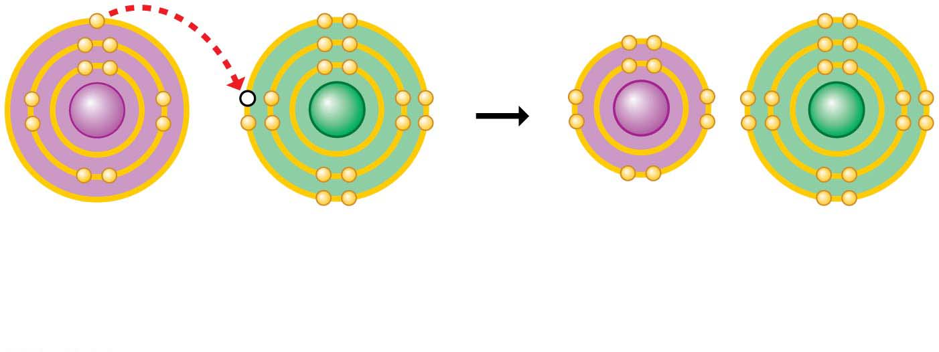
Ionic Bonds이온결합
When an atom loses or gains electrons, it becomes electrically charged.
Ions are atoms or molecules that are electrically charged as a result of gaining or losing electrons.
Ionic bonds are formed between oppositely charged ions.
Compounds, such as table salt, that are held together by ionic bonds, are called ionic compounds.
Na⁺
Sodium ion
Na
Sodium atom
Cl
Chlorine atom
Cl⁻
Chloride ion
Sodium chloride (NaCl)
Notes:
16
Student Misconceptions and Concerns
1. The dangers posed by certain chemicals in our food and broader environment often mislead people to associate “chemicals” with harm. People might not want “chemicals” added to their food or present in their environment. Students often fail to appreciate the chemical nature of our bodies and our world and the potential harm or benefits of naturally occurring chemistry. They often fail to understand why “natural” does not necessarily mean “good.” (Consider presenting a long list of naturally occurring toxins to make this point.) Your class may benefit from a class discussion of these misconceptions about our attitudes toward “chemicals.”
2. Students with limited backgrounds in chemistry and physics might struggle with basic concepts of mass, weight, compounds, elements, and isotopes. It may also be early in the semester, when mature study habits have not yet developed. Consider passing along basic studying advice and tips to help students master these early chemistry concepts. In-class quizzes (graded or not) or a few homework problems will also provide reinforcing practice.
3. The half-lives of many radioactive substances, especially those used for dating fossils, might lead some students to expect very long periods of decay for any radioactive substance. This might even be alarming if students are someday asked to consume a radioactive substance for a medical test. However, some medically significant isotopes have relatively short half-lives. Radioactive iodine-131 is often used to diagnose or treat certain thyroid problems. Its half-life of 8 days means that it will decay quickly.
Teaching Tips
1. Students might be interested in the following aside: One of the challenges of raising captive, exotic animals is meeting the unique dietary requirements of the species. A zoo might have trouble keeping a particular animal because science has not fully determined what trace elements the animal requires.
2. Many breakfast cereals are fortified with iron. A person can crush the cereal and extract distinct iron particles with a magnet. An overhead projector or video imagining device should clearly reveal the iron particles stuck to the magnet. This short practical demonstration can help connect an abstract concept to a concrete example.
3. Students with limited backgrounds in chemistry will benefit from a discussion of Figure 2.7 and the differences and limitations of diagrams of atomic structures. The contrasts in Figure 2.7 are a good beginning of such a discussion.
4. Here is a comparison that helps make the point about the differences in mass of protons and electrons. If a proton is as massive as a bowling ball, an electron will be the mass of a Life Saver candy. (This is calculated by considering a 15-pound bowling ball, a Life Saver with a mass of 0.12 ounces, and the textbook’s formula that an electron is 1/2,000 the mass of a proton.)
5. Here is an analogy regarding the size of a helium atom. If a helium atom were the size of a major league baseball stadium, the nucleus would be about the size of a pea near the pitcher’s mound, and the two electrons would be like tiny gnats buzzing around the stadium. This analogy helps to relate the great distances between parts of an atom. Consider modifying the analogy to any local stadium in your region.
6. After sharing teaching tips 4 and 5 above, consider asking your students to compare the mass of the pea near the pitcher’s mound to the mass of one of the gnats orbiting the stadium. If a proton or neutron is about 2,000 times more massive than an electron, how does the mass of a helium nucleus compare to the mass of one of its electrons?
7. Have your students try to calculate the number of covalent bonds possible for a variety of atoms. Then provide the students with a list of elements and the number of outer electrons for each and have them make predictions about the chemical formula for many types of molecules.
8. Consider challenging your students to suggest relationships in human lives that are analogous to each of the three main types of chemical bonds (covalent, ionic, and hydrogen). Evaluating the accuracy of potential analogies requires careful analysis of the chemical bonding relationships and critical thinking skills. Small groups might provide immediate critiques before passing along analogies for the entire class to consider. The following is one example. Ionic and covalent bonds are different types of relationships. Consider this analogy. A woman taking out a loan has a specific relationship to her bank. She owes the bank money, something she got from the bank. A man shares an office with another man. Both look out the same window and answer the same phone. Ionic bonds are like a bank loan, in which something is borrowed. Covalent bonds are like sharing an office, with items (electrons) shared by both members of the relationship. After presenting this analogy, ask your students to modify the office analogy to represent a polar covalent bond. (Perhaps one man in the office sits closer to the window and the phone.)
9. As noted in the text, chemical reactions do not create or destroy matter. Instead, they rearrange the structure and form new relationships. This is much like shuffling and dealing cards. When playing poker, cards are not created nor destroyed. Instead, new combinations are formed as the cards are dealt to the players.
Active Lecture Tips
1. See the Essay Electrons and Ceiling Fans on the Instructor Exchange. Visit the Instructor Exchange in the MasteringBiology instructor resource area for a description of this activity.
2. See the Essay Relating Chemical Bonds to Everyday Ideas on the Instructor Exchange. Visit the Instructor Exchange in the MasteringBiology instructor resource area for a description of this activity.

Slide 17
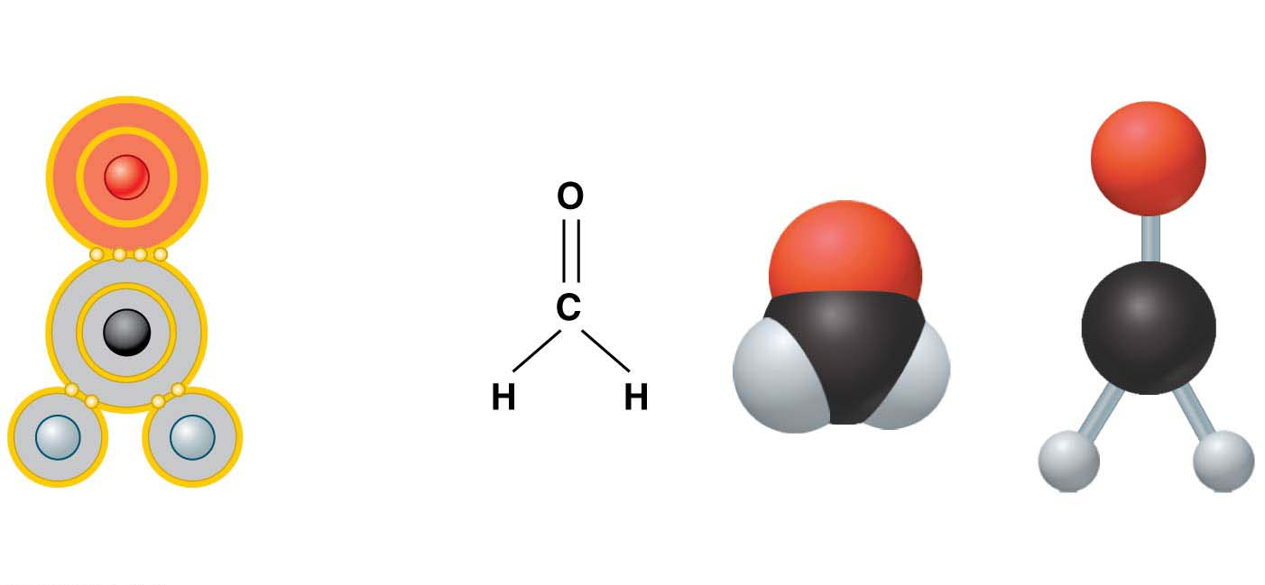
Covalent Bonds공유결합
A covalent bond forms when two atoms share one or more pairs of electrons.
Covalent bonds
are the strongest of the various bonds and
hold atoms together in a molecule분자.
Electron
configuration
Ball-and-stick
model
Structural
formula
Space-filling
model
Double bond
Single bond
Name (molecular formula) : Formaldehyde (CH₂O)
Notes:
17
Student Misconceptions and Concerns
1. The dangers posed by certain chemicals in our food and broader environment often mislead people to associate “chemicals” with harm. People might not want “chemicals” added to their food or present in their environment. Students often fail to appreciate the chemical nature of our bodies and our world and the potential harm or benefits of naturally occurring chemistry. They often fail to understand why “natural” does not necessarily mean “good.” (Consider presenting a long list of naturally occurring toxins to make this point.) Your class may benefit from a class discussion of these misconceptions about our attitudes toward “chemicals.”
2. Students with limited backgrounds in chemistry and physics might struggle with basic concepts of mass, weight, compounds, elements, and isotopes. It may also be early in the semester, when mature study habits have not yet developed. Consider passing along basic studying advice and tips to help students master these early chemistry concepts. In-class quizzes (graded or not) or a few homework problems will also provide reinforcing practice.
3. The half-lives of many radioactive substances, especially those used for dating fossils, might lead some students to expect very long periods of decay for any radioactive substance. This might even be alarming if students are someday asked to consume a radioactive substance for a medical test. However, some medically significant isotopes have relatively short half-lives. Radioactive iodine-131 is often used to diagnose or treat certain thyroid problems. Its half-life of 8 days means that it will decay quickly.
Teaching Tips
1. Students might be interested in the following aside: One of the challenges of raising captive, exotic animals is meeting the unique dietary requirements of the species. A zoo might have trouble keeping a particular animal because science has not fully determined what trace elements the animal requires.
2. Many breakfast cereals are fortified with iron. A person can crush the cereal and extract distinct iron particles with a magnet. An overhead projector or video imagining device should clearly reveal the iron particles stuck to the magnet. This short practical demonstration can help connect an abstract concept to a concrete example.
3. Students with limited backgrounds in chemistry will benefit from a discussion of Figure 2.7 and the differences and limitations of diagrams of atomic structures. The contrasts in Figure 2.7 are a good beginning of such a discussion.
4. Here is a comparison that helps make the point about the differences in mass of protons and electrons. If a proton is as massive as a bowling ball, an electron will be the mass of a Life Saver candy. (This is calculated by considering a 15-pound bowling ball, a Life Saver with a mass of 0.12 ounces, and the textbook’s formula that an electron is 1/2,000 the mass of a proton.)
5. Here is an analogy regarding the size of a helium atom. If a helium atom were the size of a major league baseball stadium, the nucleus would be about the size of a pea near the pitcher’s mound, and the two electrons would be like tiny gnats buzzing around the stadium. This analogy helps to relate the great distances between parts of an atom. Consider modifying the analogy to any local stadium in your region.
6. After sharing teaching tips 4 and 5 above, consider asking your students to compare the mass of the pea near the pitcher’s mound to the mass of one of the gnats orbiting the stadium. If a proton or neutron is about 2,000 times more massive than an electron, how does the mass of a helium nucleus compare to the mass of one of its electrons?
7. Have your students try to calculate the number of covalent bonds possible for a variety of atoms. Then provide the students with a list of elements and the number of outer electrons for each and have them make predictions about the chemical formula for many types of molecules.
8. Consider challenging your students to suggest relationships in human lives that are analogous to each of the three main types of chemical bonds (covalent, ionic, and hydrogen). Evaluating the accuracy of potential analogies requires careful analysis of the chemical bonding relationships and critical thinking skills. Small groups might provide immediate critiques before passing along analogies for the entire class to consider. The following is one example. Ionic and covalent bonds are different types of relationships. Consider this analogy. A woman taking out a loan has a specific relationship to her bank. She owes the bank money, something she got from the bank. A man shares an office with another man. Both look out the same window and answer the same phone. Ionic bonds are like a bank loan, in which something is borrowed. Covalent bonds are like sharing an office, with items (electrons) shared by both members of the relationship. After presenting this analogy, ask your students to modify the office analogy to represent a polar covalent bond. (Perhaps one man in the office sits closer to the window and the phone.)
9. As noted in the text, chemical reactions do not create or destroy matter. Instead, they rearrange the structure and form new relationships. This is much like shuffling and dealing cards. When playing poker, cards are not created nor destroyed. Instead, new combinations are formed as the cards are dealt to the players.
Active Lecture Tips
1. See the Essay Electrons and Ceiling Fans on the Instructor Exchange. Visit the Instructor Exchange in the MasteringBiology instructor resource area for a description of this activity.
2. See the Essay Relating Chemical Bonds to Everyday Ideas on the Instructor Exchange. Visit the Instructor Exchange in the MasteringBiology instructor resource area for a description of this activity.

Slide 18
Hydrogen Bonds수소결합
A molecule of water (H₂O) consists of two hydrogen atoms joined to one oxygen atom by single covalent bonds, but the electrons are not shared equally between the oxygen and hydrogen atoms.
This causes water to be a polar molecule극성분자, one with an uneven distribution of charge.
The polarity of water results in weak electrical attractions between neighboring water molecules.
These weak attractions are called hydrogen bonds.
Notes:
18
Student Misconceptions and Concerns
1. The dangers posed by certain chemicals in our food and broader environment often mislead people to associate “chemicals” with harm. People might not want “chemicals” added to their food or present in their environment. Students often fail to appreciate the chemical nature of our bodies and our world and the potential harm or benefits of naturally occurring chemistry. They often fail to understand why “natural” does not necessarily mean “good.” (Consider presenting a long list of naturally occurring toxins to make this point.) Your class may benefit from a class discussion of these misconceptions about our attitudes toward “chemicals.”
2. Students with limited backgrounds in chemistry and physics might struggle with basic concepts of mass, weight, compounds, elements, and isotopes. It may also be early in the semester, when mature study habits have not yet developed. Consider passing along basic studying advice and tips to help students master these early chemistry concepts. In-class quizzes (graded or not) or a few homework problems will also provide reinforcing practice.
3. The half-lives of many radioactive substances, especially those used for dating fossils, might lead some students to expect very long periods of decay for any radioactive substance. This might even be alarming if students are someday asked to consume a radioactive substance for a medical test. However, some medically significant isotopes have relatively short half-lives. Radioactive iodine-131 is often used to diagnose or treat certain thyroid problems. Its half-life of 8 days means that it will decay quickly.
Teaching Tips
1. Students might be interested in the following aside: One of the challenges of raising captive, exotic animals is meeting the unique dietary requirements of the species. A zoo might have trouble keeping a particular animal because science has not fully determined what trace elements the animal requires.
2. Many breakfast cereals are fortified with iron. A person can crush the cereal and extract distinct iron particles with a magnet. An overhead projector or video imagining device should clearly reveal the iron particles stuck to the magnet. This short practical demonstration can help connect an abstract concept to a concrete example.
3. Students with limited backgrounds in chemistry will benefit from a discussion of Figure 2.7 and the differences and limitations of diagrams of atomic structures. The contrasts in Figure 2.7 are a good beginning of such a discussion.
4. Here is a comparison that helps make the point about the differences in mass of protons and electrons. If a proton is as massive as a bowling ball, an electron will be the mass of a Life Saver candy. (This is calculated by considering a 15-pound bowling ball, a Life Saver with a mass of 0.12 ounces, and the textbook’s formula that an electron is 1/2,000 the mass of a proton.)
5. Here is an analogy regarding the size of a helium atom. If a helium atom were the size of a major league baseball stadium, the nucleus would be about the size of a pea near the pitcher’s mound, and the two electrons would be like tiny gnats buzzing around the stadium. This analogy helps to relate the great distances between parts of an atom. Consider modifying the analogy to any local stadium in your region.
6. After sharing teaching tips 4 and 5 above, consider asking your students to compare the mass of the pea near the pitcher’s mound to the mass of one of the gnats orbiting the stadium. If a proton or neutron is about 2,000 times more massive than an electron, how does the mass of a helium nucleus compare to the mass of one of its electrons?
7. Have your students try to calculate the number of covalent bonds possible for a variety of atoms. Then provide the students with a list of elements and the number of outer electrons for each and have them make predictions about the chemical formula for many types of molecules.
8. Consider challenging your students to suggest relationships in human lives that are analogous to each of the three main types of chemical bonds (covalent, ionic, and hydrogen). Evaluating the accuracy of potential analogies requires careful analysis of the chemical bonding relationships and critical thinking skills. Small groups might provide immediate critiques before passing along analogies for the entire class to consider. The following is one example. Ionic and covalent bonds are different types of relationships. Consider this analogy. A woman taking out a loan has a specific relationship to her bank. She owes the bank money, something she got from the bank. A man shares an office with another man. Both look out the same window and answer the same phone. Ionic bonds are like a bank loan, in which something is borrowed. Covalent bonds are like sharing an office, with items (electrons) shared by both members of the relationship. After presenting this analogy, ask your students to modify the office analogy to represent a polar covalent bond. (Perhaps one man in the office sits closer to the window and the phone.)
9. As noted in the text, chemical reactions do not create or destroy matter. Instead, they rearrange the structure and form new relationships. This is much like shuffling and dealing cards. When playing poker, cards are not created nor destroyed. Instead, new combinations are formed as the cards are dealt to the players.
Active Lecture Tips
1. See the Essay Electrons and Ceiling Fans on the Instructor Exchange. Visit the Instructor Exchange in the MasteringBiology instructor resource area for a description of this activity.
2. See the Essay Relating Chemical Bonds to Everyday Ideas on the Instructor Exchange. Visit the Instructor Exchange in the MasteringBiology instructor resource area for a description of this activity.

Slide 19
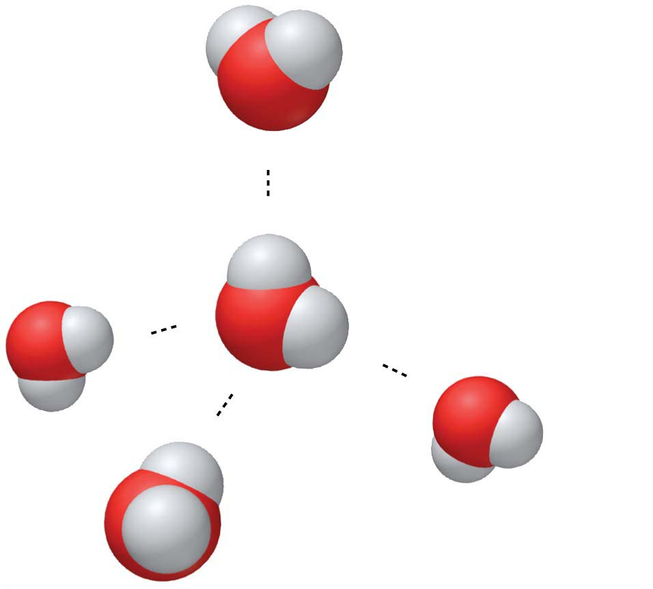
Figure 2.8
(−)
Hydrogen bond
(+)
H
Slightly positive
charge
(−)
O
H
Slightly negative
charge
(+)
(+)
(−)
(−)
(+)
Notes:
Figure 2.8 Hydrogen bonding in water

Slide 20
Hydrophobic interaction소수성 상호작용
Van der Waals interaction반데르발스 결합

Slide 21
Chemical Reactions
Cells constantly rearrange molecules by
breaking existing chemical bonds and
forming new ones.
Chemical reactions include
Reactants반응물질, the starting materials, and
Products산물, the end materials.
Chemical reactions
can rearrange matter
but cannot create or destroy matter.
Notes:
21
Student Misconceptions and Concerns
1. The dangers posed by certain chemicals in our food and broader environment often mislead people to associate “chemicals” with harm. People might not want “chemicals” added to their food or present in their environment. Students often fail to appreciate the chemical nature of our bodies and our world and the potential harm or benefits of naturally occurring chemistry. They often fail to understand why “natural” does not necessarily mean “good.” (Consider presenting a long list of naturally occurring toxins to make this point.) Your class may benefit from a class discussion of these misconceptions about our attitudes toward “chemicals.”
2. Students with limited backgrounds in chemistry and physics might struggle with basic concepts of mass, weight, compounds, elements, and isotopes. It may also be early in the semester, when mature study habits have not yet developed. Consider passing along basic studying advice and tips to help students master these early chemistry concepts. In-class quizzes (graded or not) or a few homework problems will also provide reinforcing practice.
3. The half-lives of many radioactive substances, especially those used for dating fossils, might lead some students to expect very long periods of decay for any radioactive substance. This might even be alarming if students are someday asked to consume a radioactive substance for a medical test. However, some medically significant isotopes have relatively short half-lives. Radioactive iodine-131 is often used to diagnose or treat certain thyroid problems. Its half-life of 8 days means that it will decay quickly.
Teaching Tips
1. Students might be interested in the following aside: One of the challenges of raising captive, exotic animals is meeting the unique dietary requirements of the species. A zoo might have trouble keeping a particular animal because science has not fully determined what trace elements the animal requires.
2. Many breakfast cereals are fortified with iron. A person can crush the cereal and extract distinct iron particles with a magnet. An overhead projector or video imagining device should clearly reveal the iron particles stuck to the magnet. This short practical demonstration can help connect an abstract concept to a concrete example.
3. Students with limited backgrounds in chemistry will benefit from a discussion of Figure 2.7 and the differences and limitations of diagrams of atomic structures. The contrasts in Figure 2.7 are a good beginning of such a discussion.
4. Here is a comparison that helps make the point about the differences in mass of protons and electrons. If a proton is as massive as a bowling ball, an electron will be the mass of a Life Saver candy. (This is calculated by considering a 15-pound bowling ball, a Life Saver with a mass of 0.12 ounces, and the textbook’s formula that an electron is 1/2,000 the mass of a proton.)
5. Here is an analogy regarding the size of a helium atom. If a helium atom were the size of a major league baseball stadium, the nucleus would be about the size of a pea near the pitcher’s mound, and the two electrons would be like tiny gnats buzzing around the stadium. This analogy helps to relate the great distances between parts of an atom. Consider modifying the analogy to any local stadium in your region.
6. After sharing teaching tips 4 and 5 above, consider asking your students to compare the mass of the pea near the pitcher’s mound to the mass of one of the gnats orbiting the stadium. If a proton or neutron is about 2,000 times more massive than an electron, how does the mass of a helium nucleus compare to the mass of one of its electrons?
7. Have your students try to calculate the number of covalent bonds possible for a variety of atoms. Then provide the students with a list of elements and the number of outer electrons for each and have them make predictions about the chemical formula for many types of molecules.
8. Consider challenging your students to suggest relationships in human lives that are analogous to each of the three main types of chemical bonds (covalent, ionic, and hydrogen). Evaluating the accuracy of potential analogies requires careful analysis of the chemical bonding relationships and critical thinking skills. Small groups might provide immediate critiques before passing along analogies for the entire class to consider. The following is one example. Ionic and covalent bonds are different types of relationships. Consider this analogy. A woman taking out a loan has a specific relationship to her bank. She owes the bank money, something she got from the bank. A man shares an office with another man. Both look out the same window and answer the same phone. Ionic bonds are like a bank loan, in which something is borrowed. Covalent bonds are like sharing an office, with items (electrons) shared by both members of the relationship. After presenting this analogy, ask your students to modify the office analogy to represent a polar covalent bond. (Perhaps one man in the office sits closer to the window and the phone.)
9. As noted in the text, chemical reactions do not create or destroy matter. Instead, they rearrange the structure and form new relationships. This is much like shuffling and dealing cards. When playing poker, cards are not created nor destroyed. Instead, new combinations are formed as the cards are dealt to the players.
Active Lecture Tips
1. See the Essay Electrons and Ceiling Fans on the Instructor Exchange. Visit the Instructor Exchange in the MasteringBiology instructor resource area for a description of this activity.
2. See the Essay Relating Chemical Bonds to Everyday Ideas on the Instructor Exchange. Visit the Instructor Exchange in the MasteringBiology instructor resource area for a description of this activity.

Slide 22
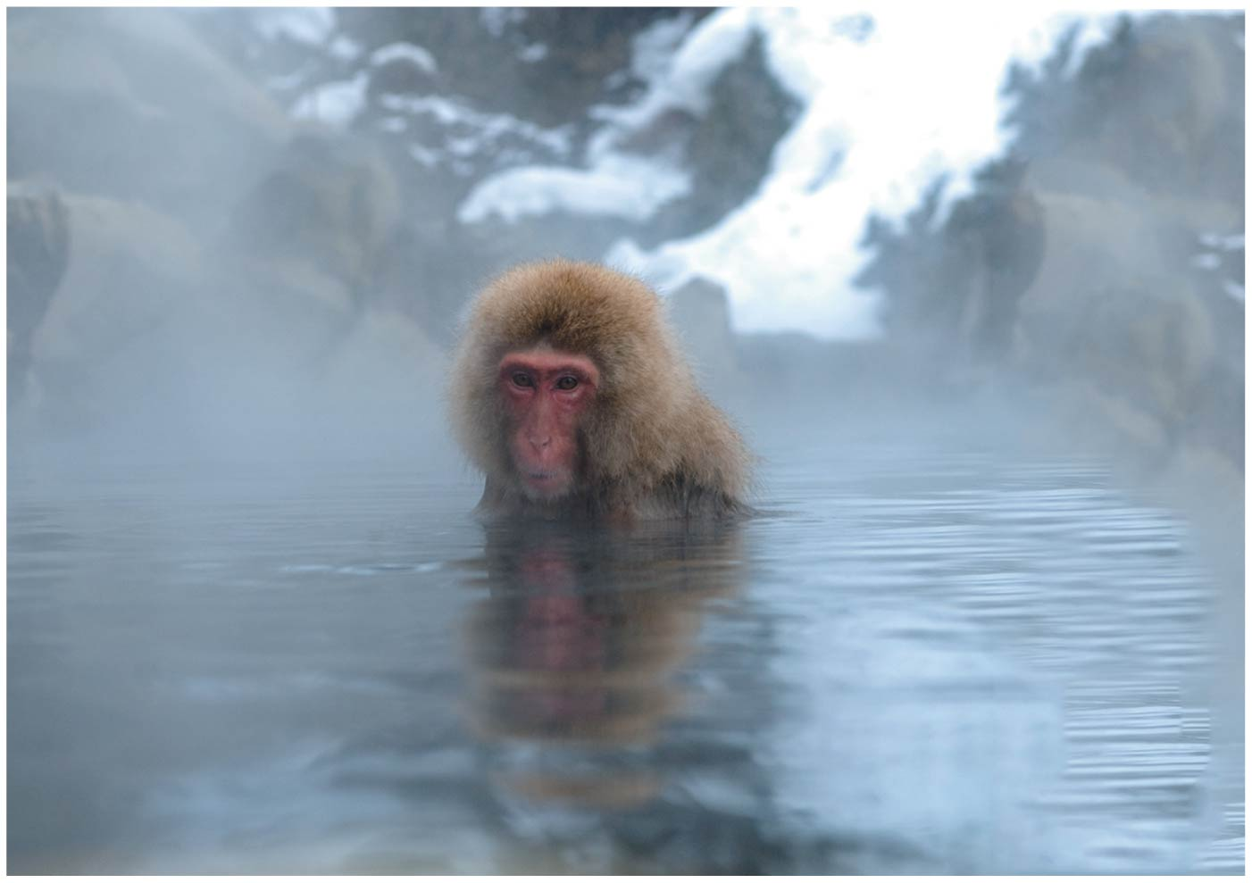
Water and Life
Life on Earth began in water and evolved there for 3 billion years before spreading onto land.
Modern life is still tied to water.
Your cells are composed of 70–95% water.
The abundance of water is a major reason that Earth is habitable.
Notes:
22
Student Misconceptions and Concerns
1. Students are unlikely to have carefully considered the four special properties of water that are apparent in our lives. However, these properties are of great biological significance and are often familiar. The connections between these properties and personal experiences can invest great meaning into a discussion of water’s properties. See Active Lecture Tips 1 and 2 below.
2. Students at all levels struggle with the distinction between heat and temperature. Students might also expect that all ice is about the same temperature, 0°C. Redefining and correcting misunderstandings often takes more class time and energy than introducing previously unknown concepts.
Teaching Tips
1. Here is a way to have your students think about the “sticky” nature of water in their lives. Ask them to consider the need for a towel after a shower or a bath. Once we get out of the shower or bath, we have left the source of water. So why do we need the towel? The reason we need a towel to dry off is that water is still clinging to our bodies because water molecules are polar. The molecules on cell surfaces are also polar, so our skin and the water both “stick” to each other.
2. Some students may be intrigued if you tell them that you too can stand on the surface of water—when it is frozen. Thus, it is necessary to note a liquid water surface when talking about surface tension.
3. Have students compare the seasonal ranges of temperatures of Anchorage and Fairbanks, Alaska. (Many websites provide weather information about various cities.) These two northern cities have large differences in their annual temperature ranges. Make the point that the coastal location of Anchorage moderates the temperature.
4. Several versions of the following analogy are easy to relate to students. (a) Ask students how the average on an exam would be affected if the brightest students did not take the test. (b) The authors note that the performance of a track team would drop if the fastest runners did not compete. In both analogies, removing the top performers lowers the average just as the evaporation of the most active water molecules cools the evaporative surface.
5. “It is not the heat, it is the humidity.” The efficiency of evaporative cooling is affected by humidity. As humidity rises, the rate of evaporation decreases, making it more difficult to cool our heat-generating bodies on a warm and humid summer day.
6. Ask your students if the ocean levels would change if ice did not float or if all the floating ice in the oceans were to melt. They can try this experiment to find out. Place several large chunks of ice in a glass and fill the glass up completely with water to the top rim. Thus, the ice cubes should be sticking up above the top of the filled glass. Will the glass overflow when the ice melts? (No.) This phenomenon is important when we consider the potential consequences of global warming. If floating glaciers melt, ocean levels will not be affected. However, if the ice over land melts, we can expect increased ocean levels.
7. A simple demonstration of a solute dissolving in a solvent can focus students’ attention on the process when discussing solutions. Using colored water and white sugar or salt may make it easier to see and reference while you are discussing the process. Such simple visual aids add life to a lecture. (You might also add corn oil to the top of the solution to demonstrate the properties of hydrophobic substances, and challenge your class to explain why oil and water do not mix.)
8. Discussions of pH are enhanced by lab activities that permit students to test the pH of everyday items (foods and household solutions). If students do not have opportunities to conduct such tests in lab, consider testing a few items during your class (pH paper or a basic pH meter will, of course, be necessary).
9. The Environmental Protection Agency website www.epa.gov/acidrain/ includes good information about acid precipitation and teaching ideas.
10. The SETI (Search for Extraterrestrial Intelligence) Institute’s mission is “to explore, understand and explain the origin, nature, and prevalence of life in the universe” (www.seti.org). Your students might enjoy exploring this respected scientific organization.
Active Lecture Tips
1. Prepare a list of examples of the four properties of water. Then present each example and ask students to work in pairs at their seats to identify the property of water associated with each example. Students will engage in higher-level analysis as they apply the properties. Students are likely to want to know the answer in what may be a surprisingly engaging class exercise!
2. The Chapter 2 text notes the insulating effect of ice forming at the surface of a lake. This phenomenon would not occur if ice were denser than water. Ask students to turn to someone near them to think of other consequences of the expansion of water when it forms ice. After perhaps two minutes, have students share their examples. (These include the ability to widen cracks in rocks, roads, and sidewalks!)
3. See the Essay The Earthquake Richter Scale and the pH Scale on the Instructor Exchange. Visit the Instructor Exchange in the MasteringBiology instructor resource area for a description of this activity.

Slide 23
Structure/Function: Water
The polarity of water molecules and the hydrogen bonding that results explain most of water’s life-supporting properties.
We will explore four of those properties:
the cohesive nature of water,
the ability of water to moderate temperature,
the biological significance of ice floating, and
the versatility of water as a solvent.
Notes:
23
Student Misconceptions and Concerns
1. Students are unlikely to have carefully considered the four special properties of water that are apparent in our lives. However, these properties are of great biological significance and are often familiar. The connections between these properties and personal experiences can invest great meaning into a discussion of water’s properties. See Active Lecture Tips 1 and 2 below.
2. Students at all levels struggle with the distinction between heat and temperature. Students might also expect that all ice is about the same temperature, 0°C. Redefining and correcting misunderstandings often takes more class time and energy than introducing previously unknown concepts.
Teaching Tips
1. Here is a way to have your students think about the “sticky” nature of water in their lives. Ask them to consider the need for a towel after a shower or a bath. Once we get out of the shower or bath, we have left the source of water. So why do we need the towel? The reason we need a towel to dry off is that water is still clinging to our bodies because water molecules are polar. The molecules on cell surfaces are also polar, so our skin and the water both “stick” to each other.
2. Some students may be intrigued if you tell them that you too can stand on the surface of water—when it is frozen. Thus, it is necessary to note a liquid water surface when talking about surface tension.
3. Have students compare the seasonal ranges of temperatures of Anchorage and Fairbanks, Alaska. (Many websites provide weather information about various cities.) These two northern cities have large differences in their annual temperature ranges. Make the point that the coastal location of Anchorage moderates the temperature.
4. Several versions of the following analogy are easy to relate to students. (a) Ask students how the average on an exam would be affected if the brightest students did not take the test. (b) The authors note that the performance of a track team would drop if the fastest runners did not compete. In both analogies, removing the top performers lowers the average just as the evaporation of the most active water molecules cools the evaporative surface.
5. “It is not the heat, it is the humidity.” The efficiency of evaporative cooling is affected by humidity. As humidity rises, the rate of evaporation decreases, making it more difficult to cool our heat-generating bodies on a warm and humid summer day.
6. Ask your students if the ocean levels would change if ice did not float or if all the floating ice in the oceans were to melt. They can try this experiment to find out. Place several large chunks of ice in a glass and fill the glass up completely with water to the top rim. Thus, the ice cubes should be sticking up above the top of the filled glass. Will the glass overflow when the ice melts? (No.) This phenomenon is important when we consider the potential consequences of global warming. If floating glaciers melt, ocean levels will not be affected. However, if the ice over land melts, we can expect increased ocean levels.
7. A simple demonstration of a solute dissolving in a solvent can focus students’ attention on the process when discussing solutions. Using colored water and white sugar or salt may make it easier to see and reference while you are discussing the process. Such simple visual aids add life to a lecture. (You might also add corn oil to the top of the solution to demonstrate the properties of hydrophobic substances, and challenge your class to explain why oil and water do not mix.)
8. Discussions of pH are enhanced by lab activities that permit students to test the pH of everyday items (foods and household solutions). If students do not have opportunities to conduct such tests in lab, consider testing a few items during your class (pH paper or a basic pH meter will, of course, be necessary).
9. The Environmental Protection Agency website www.epa.gov/acidrain/ includes good information about acid precipitation and teaching ideas.
10. The SETI (Search for Extraterrestrial Intelligence) Institute’s mission is “to explore, understand and explain the origin, nature, and prevalence of life in the universe” (www.seti.org). Your students might enjoy exploring this respected scientific organization.
Active Lecture Tips
1. Prepare a list of examples of the four properties of water. Then present each example and ask students to work in pairs at their seats to identify the property of water associated with each example. Students will engage in higher-level analysis as they apply the properties. Students are likely to want to know the answer in what may be a surprisingly engaging class exercise!
2. The Chapter 2 text notes the insulating effect of ice forming at the surface of a lake. This phenomenon would not occur if ice were denser than water. Ask students to turn to someone near them to think of other consequences of the expansion of water when it forms ice. After perhaps two minutes, have students share their examples. (These include the ability to widen cracks in rocks, roads, and sidewalks!)
3. See the Essay The Earthquake Richter Scale and the pH Scale on the Instructor Exchange. Visit the Instructor Exchange in the MasteringBiology instructor resource area for a description of this activity.

Slide 24
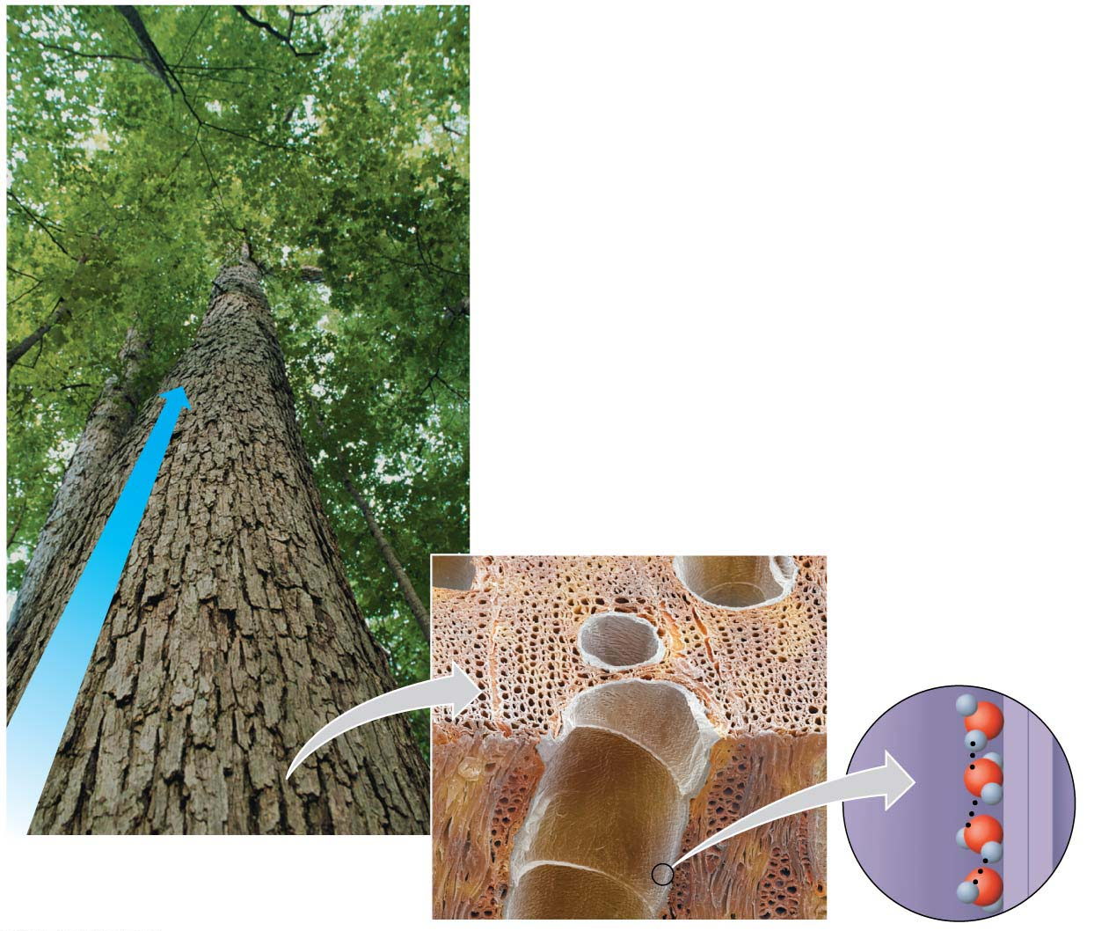
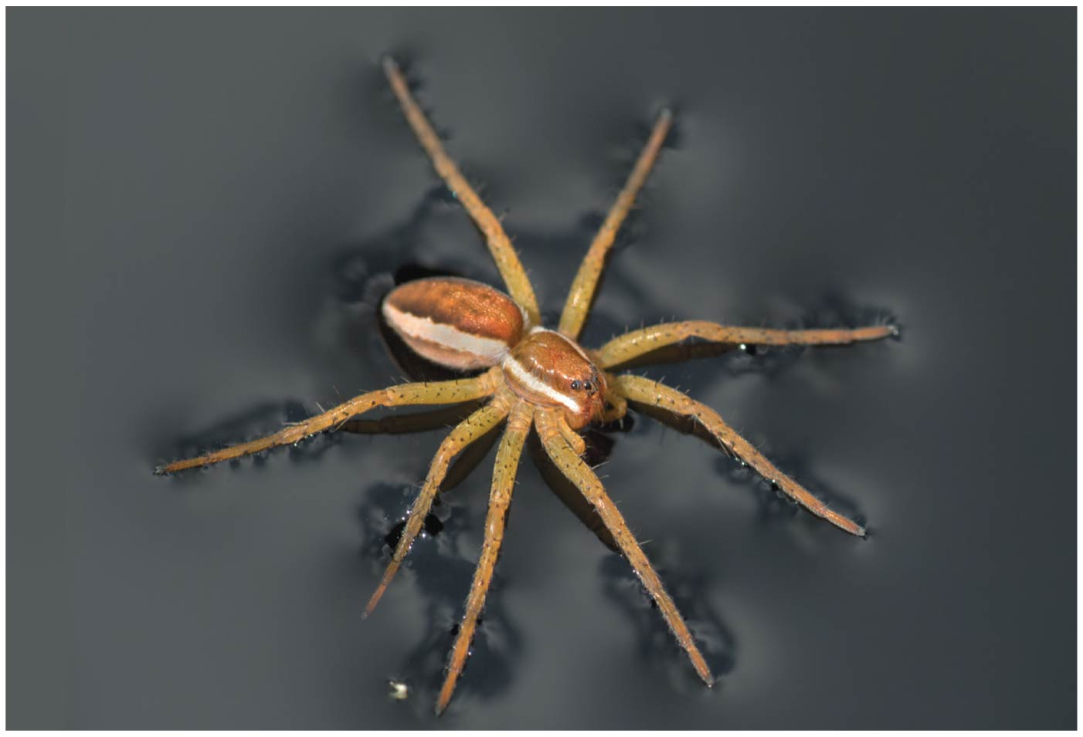
The Cohesion of Water
Water molecules stick together as a result of hydrogen bonding.
This tendency of molecules of the same kind to stick together is called cohesion응집 and is much stronger for water than for most other liquids.
Trees depend on cohesion to help transport water from their roots to their leaves.
●Hydrogen bonds give water unusually high surface tension표면장력 and make water behave as though it were coated with an invisible film.
Notes:
24
Student Misconceptions and Concerns
1. Students are unlikely to have carefully considered the four special properties of water that are apparent in our lives. However, these properties are of great biological significance and are often familiar. The connections between these properties and personal experiences can invest great meaning into a discussion of water’s properties. See Active Lecture Tips 1 and 2 below.
2. Students at all levels struggle with the distinction between heat and temperature. Students might also expect that all ice is about the same temperature, 0°C. Redefining and correcting misunderstandings often takes more class time and energy than introducing previously unknown concepts.
Teaching Tips
1. Here is a way to have your students think about the “sticky” nature of water in their lives. Ask them to consider the need for a towel after a shower or a bath. Once we get out of the shower or bath, we have left the source of water. So why do we need the towel? The reason we need a towel to dry off is that water is still clinging to our bodies because water molecules are polar. The molecules on cell surfaces are also polar, so our skin and the water both “stick” to each other.
2. Some students may be intrigued if you tell them that you too can stand on the surface of water—when it is frozen. Thus, it is necessary to note a liquid water surface when talking about surface tension.
3. Have students compare the seasonal ranges of temperatures of Anchorage and Fairbanks, Alaska. (Many websites provide weather information about various cities.) These two northern cities have large differences in their annual temperature ranges. Make the point that the coastal location of Anchorage moderates the temperature.
4. Several versions of the following analogy are easy to relate to students. (a) Ask students how the average on an exam would be affected if the brightest students did not take the test. (b) The authors note that the performance of a track team would drop if the fastest runners did not compete. In both analogies, removing the top performers lowers the average just as the evaporation of the most active water molecules cools the evaporative surface.
5. “It is not the heat, it is the humidity.” The efficiency of evaporative cooling is affected by humidity. As humidity rises, the rate of evaporation decreases, making it more difficult to cool our heat-generating bodies on a warm and humid summer day.
6. Ask your students if the ocean levels would change if ice did not float or if all the floating ice in the oceans were to melt. They can try this experiment to find out. Place several large chunks of ice in a glass and fill the glass up completely with water to the top rim. Thus, the ice cubes should be sticking up above the top of the filled glass. Will the glass overflow when the ice melts? (No.) This phenomenon is important when we consider the potential consequences of global warming. If floating glaciers melt, ocean levels will not be affected. However, if the ice over land melts, we can expect increased ocean levels.
7. A simple demonstration of a solute dissolving in a solvent can focus students’ attention on the process when discussing solutions. Using colored water and white sugar or salt may make it easier to see and reference while you are discussing the process. Such simple visual aids add life to a lecture. (You might also add corn oil to the top of the solution to demonstrate the properties of hydrophobic substances, and challenge your class to explain why oil and water do not mix.)
8. Discussions of pH are enhanced by lab activities that permit students to test the pH of everyday items (foods and household solutions). If students do not have opportunities to conduct such tests in lab, consider testing a few items during your class (pH paper or a basic pH meter will, of course, be necessary).
9. The Environmental Protection Agency website www.epa.gov/acidrain/ includes good information about acid precipitation and teaching ideas.
10. The SETI (Search for Extraterrestrial Intelligence) Institute’s mission is “to explore, understand and explain the origin, nature, and prevalence of life in the universe” (www.seti.org). Your students might enjoy exploring this respected scientific organization.
Active Lecture Tips
1. Prepare a list of examples of the four properties of water. Then present each example and ask students to work in pairs at their seats to identify the property of water associated with each example. Students will engage in higher-level analysis as they apply the properties. Students are likely to want to know the answer in what may be a surprisingly engaging class exercise!
2. The Chapter 2 text notes the insulating effect of ice forming at the surface of a lake. This phenomenon would not occur if ice were denser than water. Ask students to turn to someone near them to think of other consequences of the expansion of water when it forms ice. After perhaps two minutes, have students share their examples. (These include the ability to widen cracks in rocks, roads, and sidewalks!)
3. See the Essay The Earthquake Richter Scale and the pH Scale on the Instructor Exchange. Visit the Instructor Exchange in the MasteringBiology instructor resource area for a description of this activity.

Slide 25
Water Moderates Temperature
Because of hydrogen bonding, water has a stronger resistance to temperature change than most other substances.
When water is heated, the heat energy
first disrupts hydrogen bonds and
then makes water molecules jostle around faster.
Because heat is first used to break hydrogen bonds rather than raise the temperature, water absorbs and stores a large amount of heat while warming up only a few degrees.
Conversely, when water cools, hydrogen bonds form, a process that releases heat.
Notes:
25
Student Misconceptions and Concerns
1. Students are unlikely to have carefully considered the four special properties of water that are apparent in our lives. However, these properties are of great biological significance and are often familiar. The connections between these properties and personal experiences can invest great meaning into a discussion of water’s properties. See Active Lecture Tips 1 and 2 below.
2. Students at all levels struggle with the distinction between heat and temperature. Students might also expect that all ice is about the same temperature, 0°C. Redefining and correcting misunderstandings often takes more class time and energy than introducing previously unknown concepts.
Teaching Tips
1. Here is a way to have your students think about the “sticky” nature of water in their lives. Ask them to consider the need for a towel after a shower or a bath. Once we get out of the shower or bath, we have left the source of water. So why do we need the towel? The reason we need a towel to dry off is that water is still clinging to our bodies because water molecules are polar. The molecules on cell surfaces are also polar, so our skin and the water both “stick” to each other.
2. Some students may be intrigued if you tell them that you too can stand on the surface of water—when it is frozen. Thus, it is necessary to note a liquid water surface when talking about surface tension.
3. Have students compare the seasonal ranges of temperatures of Anchorage and Fairbanks, Alaska. (Many websites provide weather information about various cities.) These two northern cities have large differences in their annual temperature ranges. Make the point that the coastal location of Anchorage moderates the temperature.
4. Several versions of the following analogy are easy to relate to students. (a) Ask students how the average on an exam would be affected if the brightest students did not take the test. (b) The authors note that the performance of a track team would drop if the fastest runners did not compete. In both analogies, removing the top performers lowers the average just as the evaporation of the most active water molecules cools the evaporative surface.
5. “It is not the heat, it is the humidity.” The efficiency of evaporative cooling is affected by humidity. As humidity rises, the rate of evaporation decreases, making it more difficult to cool our heat-generating bodies on a warm and humid summer day.
6. Ask your students if the ocean levels would change if ice did not float or if all the floating ice in the oceans were to melt. They can try this experiment to find out. Place several large chunks of ice in a glass and fill the glass up completely with water to the top rim. Thus, the ice cubes should be sticking up above the top of the filled glass. Will the glass overflow when the ice melts? (No.) This phenomenon is important when we consider the potential consequences of global warming. If floating glaciers melt, ocean levels will not be affected. However, if the ice over land melts, we can expect increased ocean levels.
7. A simple demonstration of a solute dissolving in a solvent can focus students’ attention on the process when discussing solutions. Using colored water and white sugar or salt may make it easier to see and reference while you are discussing the process. Such simple visual aids add life to a lecture. (You might also add corn oil to the top of the solution to demonstrate the properties of hydrophobic substances, and challenge your class to explain why oil and water do not mix.)
8. Discussions of pH are enhanced by lab activities that permit students to test the pH of everyday items (foods and household solutions). If students do not have opportunities to conduct such tests in lab, consider testing a few items during your class (pH paper or a basic pH meter will, of course, be necessary).
9. The Environmental Protection Agency website www.epa.gov/acidrain/ includes good information about acid precipitation and teaching ideas.
10. The SETI (Search for Extraterrestrial Intelligence) Institute’s mission is “to explore, understand and explain the origin, nature, and prevalence of life in the universe” (www.seti.org). Your students might enjoy exploring this respected scientific organization.
Active Lecture Tips
1. Prepare a list of examples of the four properties of water. Then present each example and ask students to work in pairs at their seats to identify the property of water associated with each example. Students will engage in higher-level analysis as they apply the properties. Students are likely to want to know the answer in what may be a surprisingly engaging class exercise!
2. The Chapter 2 text notes the insulating effect of ice forming at the surface of a lake. This phenomenon would not occur if ice were denser than water. Ask students to turn to someone near them to think of other consequences of the expansion of water when it forms ice. After perhaps two minutes, have students share their examples. (These include the ability to widen cracks in rocks, roads, and sidewalks!)
3. See the Essay The Earthquake Richter Scale and the pH Scale on the Instructor Exchange. Visit the Instructor Exchange in the MasteringBiology instructor resource area for a description of this activity.

Slide 26
Earth’s giant water supply enables temperatures on the planet to stay within limits that permit life by
storing a huge amount of heat from the sun during warm periods and
giving off heat that warms the air during cold periods.
Evaporative cooling증발냉각 occurs when a substance evaporates and the surface of the liquid remaining behind cools down.
Notes:
26
Student Misconceptions and Concerns
1. Students are unlikely to have carefully considered the four special properties of water that are apparent in our lives. However, these properties are of great biological significance and are often familiar. The connections between these properties and personal experiences can invest great meaning into a discussion of water’s properties. See Active Lecture Tips 1 and 2 below.
2. Students at all levels struggle with the distinction between heat and temperature. Students might also expect that all ice is about the same temperature, 0°C. Redefining and correcting misunderstandings often takes more class time and energy than introducing previously unknown concepts.
Teaching Tips
1. Here is a way to have your students think about the “sticky” nature of water in their lives. Ask them to consider the need for a towel after a shower or a bath. Once we get out of the shower or bath, we have left the source of water. So why do we need the towel? The reason we need a towel to dry off is that water is still clinging to our bodies because water molecules are polar. The molecules on cell surfaces are also polar, so our skin and the water both “stick” to each other.
2. Some students may be intrigued if you tell them that you too can stand on the surface of water—when it is frozen. Thus, it is necessary to note a liquid water surface when talking about surface tension.
3. Have students compare the seasonal ranges of temperatures of Anchorage and Fairbanks, Alaska. (Many websites provide weather information about various cities.) These two northern cities have large differences in their annual temperature ranges. Make the point that the coastal location of Anchorage moderates the temperature.
4. Several versions of the following analogy are easy to relate to students. (a) Ask students how the average on an exam would be affected if the brightest students did not take the test. (b) The authors note that the performance of a track team would drop if the fastest runners did not compete. In both analogies, removing the top performers lowers the average just as the evaporation of the most active water molecules cools the evaporative surface.
5. “It is not the heat, it is the humidity.” The efficiency of evaporative cooling is affected by humidity. As humidity rises, the rate of evaporation decreases, making it more difficult to cool our heat-generating bodies on a warm and humid summer day.
6. Ask your students if the ocean levels would change if ice did not float or if all the floating ice in the oceans were to melt. They can try this experiment to find out. Place several large chunks of ice in a glass and fill the glass up completely with water to the top rim. Thus, the ice cubes should be sticking up above the top of the filled glass. Will the glass overflow when the ice melts? (No.) This phenomenon is important when we consider the potential consequences of global warming. If floating glaciers melt, ocean levels will not be affected. However, if the ice over land melts, we can expect increased ocean levels.
7. A simple demonstration of a solute dissolving in a solvent can focus students’ attention on the process when discussing solutions. Using colored water and white sugar or salt may make it easier to see and reference while you are discussing the process. Such simple visual aids add life to a lecture. (You might also add corn oil to the top of the solution to demonstrate the properties of hydrophobic substances, and challenge your class to explain why oil and water do not mix.)
8. Discussions of pH are enhanced by lab activities that permit students to test the pH of everyday items (foods and household solutions). If students do not have opportunities to conduct such tests in lab, consider testing a few items during your class (pH paper or a basic pH meter will, of course, be necessary).
9. The Environmental Protection Agency website www.epa.gov/acidrain/ includes good information about acid precipitation and teaching ideas.
10. The SETI (Search for Extraterrestrial Intelligence) Institute’s mission is “to explore, understand and explain the origin, nature, and prevalence of life in the universe” (www.seti.org). Your students might enjoy exploring this respected scientific organization.
Active Lecture Tips
1. Prepare a list of examples of the four properties of water. Then present each example and ask students to work in pairs at their seats to identify the property of water associated with each example. Students will engage in higher-level analysis as they apply the properties. Students are likely to want to know the answer in what may be a surprisingly engaging class exercise!
2. The Chapter 2 text notes the insulating effect of ice forming at the surface of a lake. This phenomenon would not occur if ice were denser than water. Ask students to turn to someone near them to think of other consequences of the expansion of water when it forms ice. After perhaps two minutes, have students share their examples. (These include the ability to widen cracks in rocks, roads, and sidewalks!)
3. See the Essay The Earthquake Richter Scale and the pH Scale on the Instructor Exchange. Visit the Instructor Exchange in the MasteringBiology instructor resource area for a description of this activity.

Slide 27
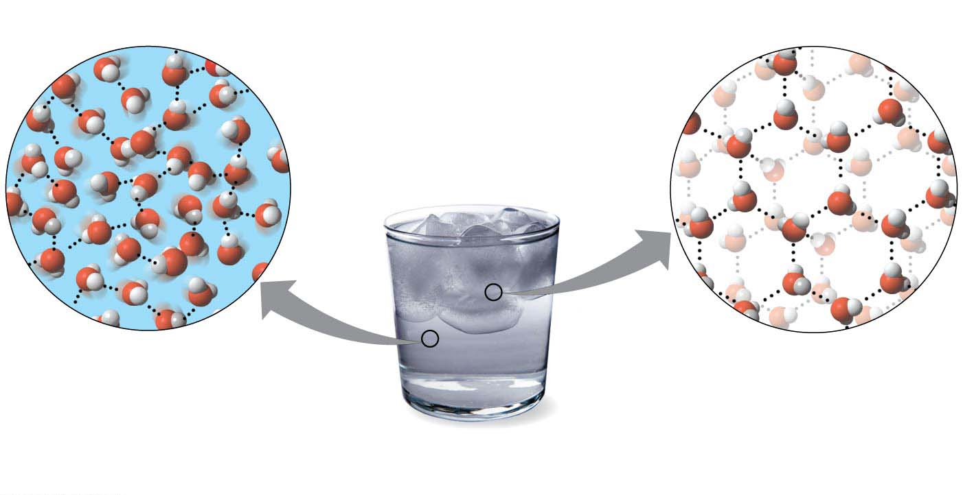
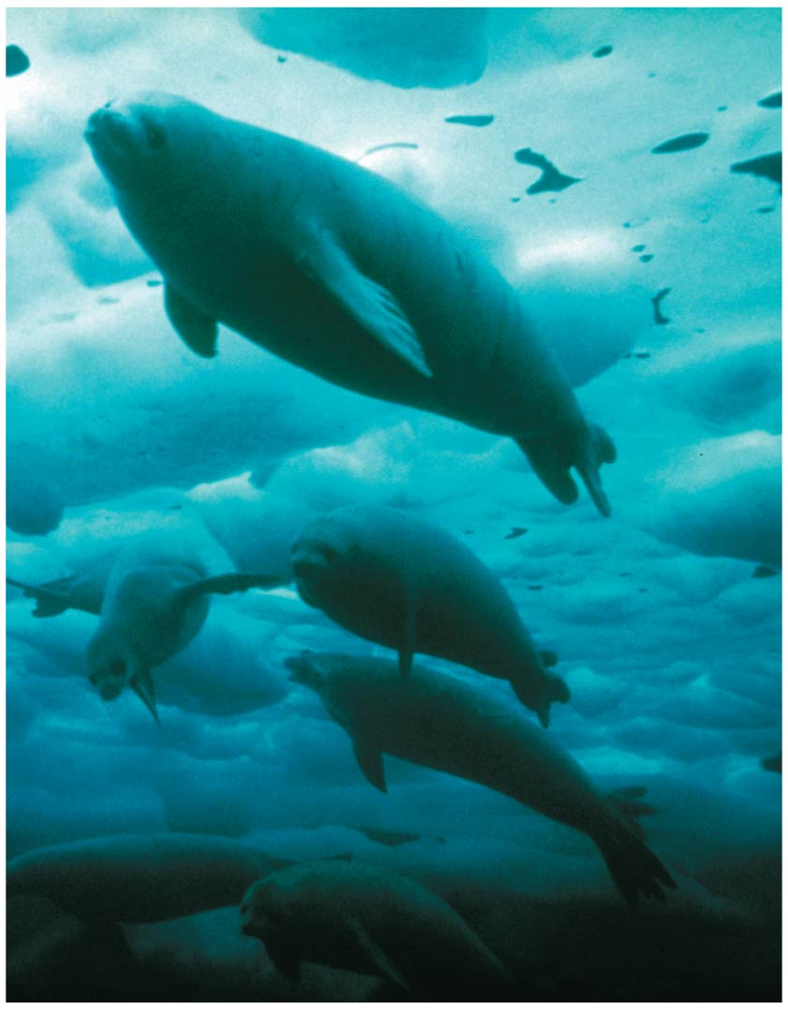
The Biological Significance of Ice Floating
When water molecules get cold enough, they move apart, forming ice.
A chunk of ice floats because it is less dense than the liquid water in which it is floating.
Hydrogen bond
Liquid water
Hydrogen bonds constantly
break and re-form.
Ice
Stable hydrogen bonds
hold molecules apart,
making ice less dense
than water.
Notes:
27
Student Misconceptions and Concerns
1. Students are unlikely to have carefully considered the four special properties of water that are apparent in our lives. However, these properties are of great biological significance and are often familiar. The connections between these properties and personal experiences can invest great meaning into a discussion of water’s properties. See Active Lecture Tips 1 and 2 below.
2. Students at all levels struggle with the distinction between heat and temperature. Students might also expect that all ice is about the same temperature, 0°C. Redefining and correcting misunderstandings often takes more class time and energy than introducing previously unknown concepts.
Teaching Tips
1. Here is a way to have your students think about the “sticky” nature of water in their lives. Ask them to consider the need for a towel after a shower or a bath. Once we get out of the shower or bath, we have left the source of water. So why do we need the towel? The reason we need a towel to dry off is that water is still clinging to our bodies because water molecules are polar. The molecules on cell surfaces are also polar, so our skin and the water both “stick” to each other.
2. Some students may be intrigued if you tell them that you too can stand on the surface of water—when it is frozen. Thus, it is necessary to note a liquid water surface when talking about surface tension.
3. Have students compare the seasonal ranges of temperatures of Anchorage and Fairbanks, Alaska. (Many websites provide weather information about various cities.) These two northern cities have large differences in their annual temperature ranges. Make the point that the coastal location of Anchorage moderates the temperature.
4. Several versions of the following analogy are easy to relate to students. (a) Ask students how the average on an exam would be affected if the brightest students did not take the test. (b) The authors note that the performance of a track team would drop if the fastest runners did not compete. In both analogies, removing the top performers lowers the average just as the evaporation of the most active water molecules cools the evaporative surface.
5. “It is not the heat, it is the humidity.” The efficiency of evaporative cooling is affected by humidity. As humidity rises, the rate of evaporation decreases, making it more difficult to cool our heat-generating bodies on a warm and humid summer day.
6. Ask your students if the ocean levels would change if ice did not float or if all the floating ice in the oceans were to melt. They can try this experiment to find out. Place several large chunks of ice in a glass and fill the glass up completely with water to the top rim. Thus, the ice cubes should be sticking up above the top of the filled glass. Will the glass overflow when the ice melts? (No.) This phenomenon is important when we consider the potential consequences of global warming. If floating glaciers melt, ocean levels will not be affected. However, if the ice over land melts, we can expect increased ocean levels.
7. A simple demonstration of a solute dissolving in a solvent can focus students’ attention on the process when discussing solutions. Using colored water and white sugar or salt may make it easier to see and reference while you are discussing the process. Such simple visual aids add life to a lecture. (You might also add corn oil to the top of the solution to demonstrate the properties of hydrophobic substances, and challenge your class to explain why oil and water do not mix.)
8. Discussions of pH are enhanced by lab activities that permit students to test the pH of everyday items (foods and household solutions). If students do not have opportunities to conduct such tests in lab, consider testing a few items during your class (pH paper or a basic pH meter will, of course, be necessary).
9. The Environmental Protection Agency website www.epa.gov/acidrain/ includes good information about acid precipitation and teaching ideas.
10. The SETI (Search for Extraterrestrial Intelligence) Institute’s mission is “to explore, understand and explain the origin, nature, and prevalence of life in the universe” (www.seti.org). Your students might enjoy exploring this respected scientific organization.
Active Lecture Tips
1. Prepare a list of examples of the four properties of water. Then present each example and ask students to work in pairs at their seats to identify the property of water associated with each example. Students will engage in higher-level analysis as they apply the properties. Students are likely to want to know the answer in what may be a surprisingly engaging class exercise!
2. The Chapter 2 text notes the insulating effect of ice forming at the surface of a lake. This phenomenon would not occur if ice were denser than water. Ask students to turn to someone near them to think of other consequences of the expansion of water when it forms ice. After perhaps two minutes, have students share their examples. (These include the ability to widen cracks in rocks, roads, and sidewalks!)
3. See the Essay The Earthquake Richter Scale and the pH Scale on the Instructor Exchange. Visit the Instructor Exchange in the MasteringBiology instructor resource area for a description of this activity.

Slide 28
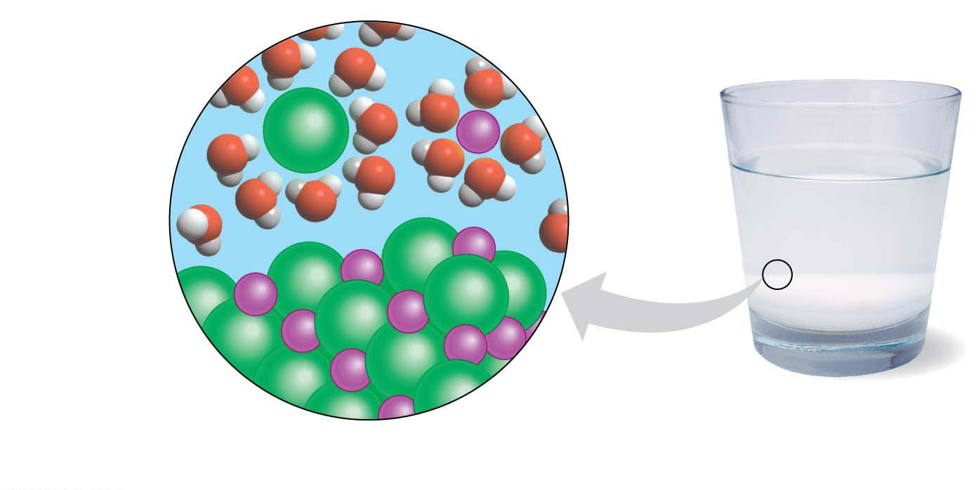
Water as the Solvent of Life
A solution용액 is a liquid consisting of a homogeneous mixture of two or more substances.
The dissolving agent is the solvent용매.
The dissolved substance is the solute용질.
When water is the solvent, the result is an aqueous solution수용액.
Water can dissolve an enormous variety of solutes necessary for life, providing a medium for chemical reactions.
When water dissolves salt ions, each ion becomes surrounded by oppositely charged regions of water molecules.
Salt crystal
Notes:
28
Student Misconceptions and Concerns
1. Students are unlikely to have carefully considered the four special properties of water that are apparent in our lives. However, these properties are of great biological significance and are often familiar. The connections between these properties and personal experiences can invest great meaning into a discussion of water’s properties. See Active Lecture Tips 1 and 2 below.
2. Students at all levels struggle with the distinction between heat and temperature. Students might also expect that all ice is about the same temperature, 0°C. Redefining and correcting misunderstandings often takes more class time and energy than introducing previously unknown concepts.
Teaching Tips
1. Here is a way to have your students think about the “sticky” nature of water in their lives. Ask them to consider the need for a towel after a shower or a bath. Once we get out of the shower or bath, we have left the source of water. So why do we need the towel? The reason we need a towel to dry off is that water is still clinging to our bodies because water molecules are polar. The molecules on cell surfaces are also polar, so our skin and the water both “stick” to each other.
2. Some students may be intrigued if you tell them that you too can stand on the surface of water—when it is frozen. Thus, it is necessary to note a liquid water surface when talking about surface tension.
3. Have students compare the seasonal ranges of temperatures of Anchorage and Fairbanks, Alaska. (Many websites provide weather information about various cities.) These two northern cities have large differences in their annual temperature ranges. Make the point that the coastal location of Anchorage moderates the temperature.
4. Several versions of the following analogy are easy to relate to students. (a) Ask students how the average on an exam would be affected if the brightest students did not take the test. (b) The authors note that the performance of a track team would drop if the fastest runners did not compete. In both analogies, removing the top performers lowers the average just as the evaporation of the most active water molecules cools the evaporative surface.
5. “It is not the heat, it is the humidity.” The efficiency of evaporative cooling is affected by humidity. As humidity rises, the rate of evaporation decreases, making it more difficult to cool our heat-generating bodies on a warm and humid summer day.
6. Ask your students if the ocean levels would change if ice did not float or if all the floating ice in the oceans were to melt. They can try this experiment to find out. Place several large chunks of ice in a glass and fill the glass up completely with water to the top rim. Thus, the ice cubes should be sticking up above the top of the filled glass. Will the glass overflow when the ice melts? (No.) This phenomenon is important when we consider the potential consequences of global warming. If floating glaciers melt, ocean levels will not be affected. However, if the ice over land melts, we can expect increased ocean levels.
7. A simple demonstration of a solute dissolving in a solvent can focus students’ attention on the process when discussing solutions. Using colored water and white sugar or salt may make it easier to see and reference while you are discussing the process. Such simple visual aids add life to a lecture. (You might also add corn oil to the top of the solution to demonstrate the properties of hydrophobic substances, and challenge your class to explain why oil and water do not mix.)
8. Discussions of pH are enhanced by lab activities that permit students to test the pH of everyday items (foods and household solutions). If students do not have opportunities to conduct such tests in lab, consider testing a few items during your class (pH paper or a basic pH meter will, of course, be necessary).
9. The Environmental Protection Agency website www.epa.gov/acidrain/ includes good information about acid precipitation and teaching ideas.
10. The SETI (Search for Extraterrestrial Intelligence) Institute’s mission is “to explore, understand and explain the origin, nature, and prevalence of life in the universe” (www.seti.org). Your students might enjoy exploring this respected scientific organization.
Active Lecture Tips
1. Prepare a list of examples of the four properties of water. Then present each example and ask students to work in pairs at their seats to identify the property of water associated with each example. Students will engage in higher-level analysis as they apply the properties. Students are likely to want to know the answer in what may be a surprisingly engaging class exercise!
2. The Chapter 2 text notes the insulating effect of ice forming at the surface of a lake. This phenomenon would not occur if ice were denser than water. Ask students to turn to someone near them to think of other consequences of the expansion of water when it forms ice. After perhaps two minutes, have students share their examples. (These include the ability to widen cracks in rocks, roads, and sidewalks!)
3. See the Essay The Earthquake Richter Scale and the pH Scale on the Instructor Exchange. Visit the Instructor Exchange in the MasteringBiology instructor resource area for a description of this activity.

Slide 29
Acids, Bases, and pH
A chemical compound that releases H⁺ to a solution is an acid산.
A compound that accepts H⁺ and removes them from solution is a base염기.
To describe the acidity of a solution, chemists use the pH scale, a measure of the hydrogen ion (H⁺) concentration in a solution.
The scale ranges from 0 (most acidic) to 14 (most basic)
Each pH unit represents a tenfold change in the concentration of H⁺.
pH = − log [H⁺]
Notes:
29
Student Misconceptions and Concerns
1. Students are unlikely to have carefully considered the four special properties of water that are apparent in our lives. However, these properties are of great biological significance and are often familiar. The connections between these properties and personal experiences can invest great meaning into a discussion of water’s properties. See Active Lecture Tips 1 and 2 below.
2. Students at all levels struggle with the distinction between heat and temperature. Students might also expect that all ice is about the same temperature, 0°C. Redefining and correcting misunderstandings often takes more class time and energy than introducing previously unknown concepts.
Teaching Tips
1. Here is a way to have your students think about the “sticky” nature of water in their lives. Ask them to consider the need for a towel after a shower or a bath. Once we get out of the shower or bath, we have left the source of water. So why do we need the towel? The reason we need a towel to dry off is that water is still clinging to our bodies because water molecules are polar. The molecules on cell surfaces are also polar, so our skin and the water both “stick” to each other.
2. Some students may be intrigued if you tell them that you too can stand on the surface of water—when it is frozen. Thus, it is necessary to note a liquid water surface when talking about surface tension.
3. Have students compare the seasonal ranges of temperatures of Anchorage and Fairbanks, Alaska. (Many websites provide weather information about various cities.) These two northern cities have large differences in their annual temperature ranges. Make the point that the coastal location of Anchorage moderates the temperature.
4. Several versions of the following analogy are easy to relate to students. (a) Ask students how the average on an exam would be affected if the brightest students did not take the test. (b) The authors note that the performance of a track team would drop if the fastest runners did not compete. In both analogies, removing the top performers lowers the average just as the evaporation of the most active water molecules cools the evaporative surface.
5. “It is not the heat, it is the humidity.” The efficiency of evaporative cooling is affected by humidity. As humidity rises, the rate of evaporation decreases, making it more difficult to cool our heat-generating bodies on a warm and humid summer day.
6. Ask your students if the ocean levels would change if ice did not float or if all the floating ice in the oceans were to melt. They can try this experiment to find out. Place several large chunks of ice in a glass and fill the glass up completely with water to the top rim. Thus, the ice cubes should be sticking up above the top of the filled glass. Will the glass overflow when the ice melts? (No.) This phenomenon is important when we consider the potential consequences of global warming. If floating glaciers melt, ocean levels will not be affected. However, if the ice over land melts, we can expect increased ocean levels.
7. A simple demonstration of a solute dissolving in a solvent can focus students’ attention on the process when discussing solutions. Using colored water and white sugar or salt may make it easier to see and reference while you are discussing the process. Such simple visual aids add life to a lecture. (You might also add corn oil to the top of the solution to demonstrate the properties of hydrophobic substances, and challenge your class to explain why oil and water do not mix.)
8. Discussions of pH are enhanced by lab activities that permit students to test the pH of everyday items (foods and household solutions). If students do not have opportunities to conduct such tests in lab, consider testing a few items during your class (pH paper or a basic pH meter will, of course, be necessary).
9. The Environmental Protection Agency website www.epa.gov/acidrain/ includes good information about acid precipitation and teaching ideas.
10. The SETI (Search for Extraterrestrial Intelligence) Institute’s mission is “to explore, understand and explain the origin, nature, and prevalence of life in the universe” (www.seti.org). Your students might enjoy exploring this respected scientific organization.
Active Lecture Tips
1. Prepare a list of examples of the four properties of water. Then present each example and ask students to work in pairs at their seats to identify the property of water associated with each example. Students will engage in higher-level analysis as they apply the properties. Students are likely to want to know the answer in what may be a surprisingly engaging class exercise!
2. The Chapter 2 text notes the insulating effect of ice forming at the surface of a lake. This phenomenon would not occur if ice were denser than water. Ask students to turn to someone near them to think of other consequences of the expansion of water when it forms ice. After perhaps two minutes, have students share their examples. (These include the ability to widen cracks in rocks, roads, and sidewalks!)
3. See the Essay The Earthquake Richter Scale and the pH Scale on the Instructor Exchange. Visit the Instructor Exchange in the MasteringBiology instructor resource area for a description of this activity.

Slide 30
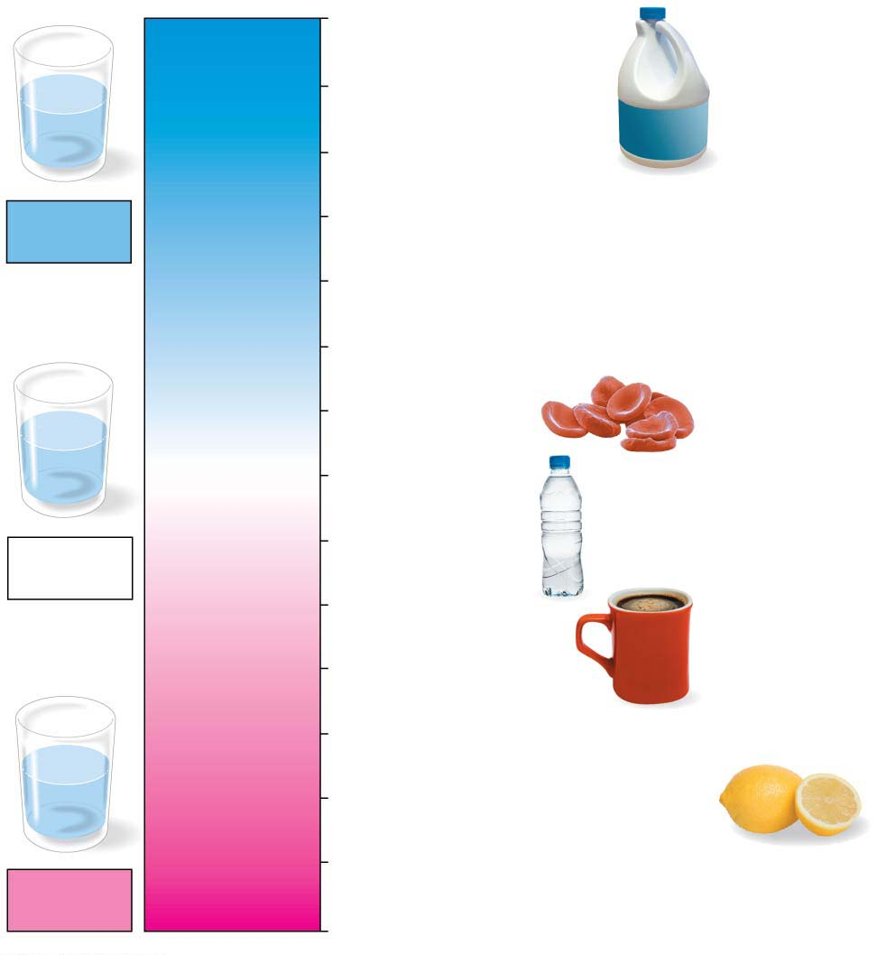
Figure 2.15
14
Oven cleaner
OH⁻
Lower H⁺ concentration
13
Household bleach
OH⁻
OH⁻
OH⁻
H⁺
OH⁻
OH⁻
H⁺
12
Household ammonia
Basic
solution
11
Milk of magnesia
10
9
Seawater
8
OH⁻
H⁺
Human blood
OH⁻
OH⁻
H⁺
[H⁺] = [OH⁻]
7
Pure water
H⁺
OH⁻
H⁺
Neutral
solution
6
Urine
Greater H⁺ concentration
5
Black coffee
4
Tomato juice
3
Grapefruit juice, soft drink
H⁺
H⁺
2
Lemon juice, stomach acid
OH⁻
H⁺
H⁺
H⁺
H⁺
OH⁻
1
Battery acid
Acidic
solution
0
pH scale
Notes:
Figure 2.15 The pH scale

Slide 31
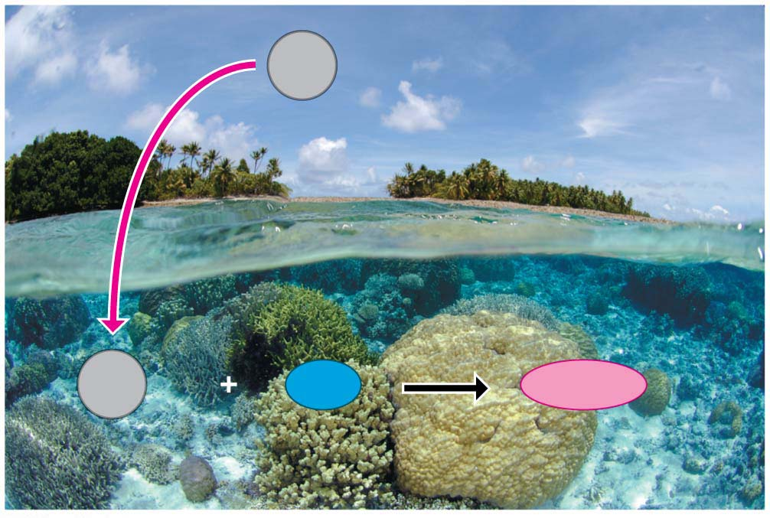
Buffers완충제 are substances that minimize changes in pH. Buffers
accept H⁺ when they are in excess and
donate H⁺ when they are depleted.
When CO₂ dissolves in seawater, it reacts with water to form an acid, which
lowers ocean pH and
can greatly change
marine environments.
CO₂
CO₂
Water
Carbonic acid
Notes:
31
Student Misconceptions and Concerns
1. Students are unlikely to have carefully considered the four special properties of water that are apparent in our lives. However, these properties are of great biological significance and are often familiar. The connections between these properties and personal experiences can invest great meaning into a discussion of water’s properties. See Active Lecture Tips 1 and 2 below.
2. Students at all levels struggle with the distinction between heat and temperature. Students might also expect that all ice is about the same temperature, 0°C. Redefining and correcting misunderstandings often takes more class time and energy than introducing previously unknown concepts.
Teaching Tips
1. Here is a way to have your students think about the “sticky” nature of water in their lives. Ask them to consider the need for a towel after a shower or a bath. Once we get out of the shower or bath, we have left the source of water. So why do we need the towel? The reason we need a towel to dry off is that water is still clinging to our bodies because water molecules are polar. The molecules on cell surfaces are also polar, so our skin and the water both “stick” to each other.
2. Some students may be intrigued if you tell them that you too can stand on the surface of water—when it is frozen. Thus, it is necessary to note a liquid water surface when talking about surface tension.
3. Have students compare the seasonal ranges of temperatures of Anchorage and Fairbanks, Alaska. (Many websites provide weather information about various cities.) These two northern cities have large differences in their annual temperature ranges. Make the point that the coastal location of Anchorage moderates the temperature.
4. Several versions of the following analogy are easy to relate to students. (a) Ask students how the average on an exam would be affected if the brightest students did not take the test. (b) The authors note that the performance of a track team would drop if the fastest runners did not compete. In both analogies, removing the top performers lowers the average just as the evaporation of the most active water molecules cools the evaporative surface.
5. “It is not the heat, it is the humidity.” The efficiency of evaporative cooling is affected by humidity. As humidity rises, the rate of evaporation decreases, making it more difficult to cool our heat-generating bodies on a warm and humid summer day.
6. Ask your students if the ocean levels would change if ice did not float or if all the floating ice in the oceans were to melt. They can try this experiment to find out. Place several large chunks of ice in a glass and fill the glass up completely with water to the top rim. Thus, the ice cubes should be sticking up above the top of the filled glass. Will the glass overflow when the ice melts? (No.) This phenomenon is important when we consider the potential consequences of global warming. If floating glaciers melt, ocean levels will not be affected. However, if the ice over land melts, we can expect increased ocean levels.
7. A simple demonstration of a solute dissolving in a solvent can focus students’ attention on the process when discussing solutions. Using colored water and white sugar or salt may make it easier to see and reference while you are discussing the process. Such simple visual aids add life to a lecture. (You might also add corn oil to the top of the solution to demonstrate the properties of hydrophobic substances, and challenge your class to explain why oil and water do not mix.)
8. Discussions of pH are enhanced by lab activities that permit students to test the pH of everyday items (foods and household solutions). If students do not have opportunities to conduct such tests in lab, consider testing a few items during your class (pH paper or a basic pH meter will, of course, be necessary).
9. The Environmental Protection Agency website www.epa.gov/acidrain/ includes good information about acid precipitation and teaching ideas.
10. The SETI (Search for Extraterrestrial Intelligence) Institute’s mission is “to explore, understand and explain the origin, nature, and prevalence of life in the universe” (www.seti.org). Your students might enjoy exploring this respected scientific organization.
Active Lecture Tips
1. Prepare a list of examples of the four properties of water. Then present each example and ask students to work in pairs at their seats to identify the property of water associated with each example. Students will engage in higher-level analysis as they apply the properties. Students are likely to want to know the answer in what may be a surprisingly engaging class exercise!
2. The Chapter 2 text notes the insulating effect of ice forming at the surface of a lake. This phenomenon would not occur if ice were denser than water. Ask students to turn to someone near them to think of other consequences of the expansion of water when it forms ice. After perhaps two minutes, have students share their examples. (These include the ability to widen cracks in rocks, roads, and sidewalks!)
3. See the Essay The Earthquake Richter Scale and the pH Scale on the Instructor Exchange. Visit the Instructor Exchange in the MasteringBiology instructor resource area for a description of this activity.

Slide 32
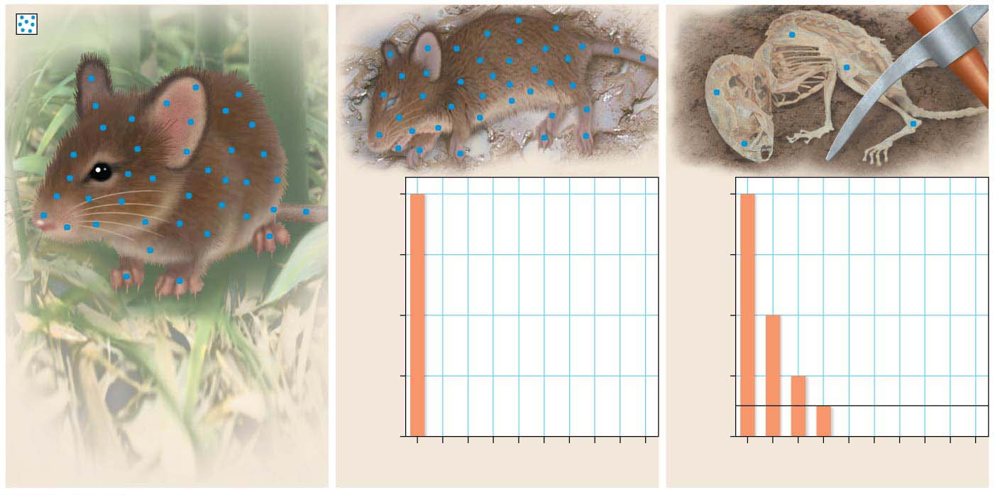
Radioactivity as an Evolutionary Clock진화시계
The natural process of radioactive decay can be used to obtain important data about the evolutionary history of life on Earth.
Fossils are reliable chronological records of life because we can determine their ages through radiometric dating, which is based on the decay of radioactive isotopes.
Carbon-14
living organism’s C-14 to C-12 ratio)
Carbon-14 radioactivity (as % of
100
75
50
25
0
Time (thousands of years)
Time (thousands of years)
Notes:
32
Student Misconceptions and Concerns
1. Students are unlikely to have carefully considered the four special properties of water that are apparent in our lives. However, these properties are of great biological significance and are often familiar. The connections between these properties and personal experiences can invest great meaning into a discussion of water’s properties. See Active Lecture Tips 1 and 2 below.
2. Students at all levels struggle with the distinction between heat and temperature. Students might also expect that all ice is about the same temperature, 0°C. Redefining and correcting misunderstandings often takes more class time and energy than introducing previously unknown concepts.
Teaching Tips
1. Here is a way to have your students think about the “sticky” nature of water in their lives. Ask them to consider the need for a towel after a shower or a bath. Once we get out of the shower or bath, we have left the source of water. So why do we need the towel? The reason we need a towel to dry off is that water is still clinging to our bodies because water molecules are polar. The molecules on cell surfaces are also polar, so our skin and the water both “stick” to each other.
2. Some students may be intrigued if you tell them that you too can stand on the surface of water—when it is frozen. Thus, it is necessary to note a liquid water surface when talking about surface tension.
3. Have students compare the seasonal ranges of temperatures of Anchorage and Fairbanks, Alaska. (Many websites provide weather information about various cities.) These two northern cities have large differences in their annual temperature ranges. Make the point that the coastal location of Anchorage moderates the temperature.
4. Several versions of the following analogy are easy to relate to students. (a) Ask students how the average on an exam would be affected if the brightest students did not take the test. (b) The authors note that the performance of a track team would drop if the fastest runners did not compete. In both analogies, removing the top performers lowers the average just as the evaporation of the most active water molecules cools the evaporative surface.
5. “It is not the heat, it is the humidity.” The efficiency of evaporative cooling is affected by humidity. As humidity rises, the rate of evaporation decreases, making it more difficult to cool our heat-generating bodies on a warm and humid summer day.
6. Ask your students if the ocean levels would change if ice did not float or if all the floating ice in the oceans were to melt. They can try this experiment to find out. Place several large chunks of ice in a glass and fill the glass up completely with water to the top rim. Thus, the ice cubes should be sticking up above the top of the filled glass. Will the glass overflow when the ice melts? (No.) This phenomenon is important when we consider the potential consequences of global warming. If floating glaciers melt, ocean levels will not be affected. However, if the ice over land melts, we can expect increased ocean levels.
7. A simple demonstration of a solute dissolving in a solvent can focus students’ attention on the process when discussing solutions. Using colored water and white sugar or salt may make it easier to see and reference while you are discussing the process. Such simple visual aids add life to a lecture. (You might also add corn oil to the top of the solution to demonstrate the properties of hydrophobic substances, and challenge your class to explain why oil and water do not mix.)
8. Discussions of pH are enhanced by lab activities that permit students to test the pH of everyday items (foods and household solutions). If students do not have opportunities to conduct such tests in lab, consider testing a few items during your class (pH paper or a basic pH meter will, of course, be necessary).
9. The Environmental Protection Agency website www.epa.gov/acidrain/ includes good information about acid precipitation and teaching ideas.
10. The SETI (Search for Extraterrestrial Intelligence) Institute’s mission is “to explore, understand and explain the origin, nature, and prevalence of life in the universe” (www.seti.org). Your students might enjoy exploring this respected scientific organization.
Active Lecture Tips
1. Prepare a list of examples of the four properties of water. Then present each example and ask students to work in pairs at their seats to identify the property of water associated with each example. Students will engage in higher-level analysis as they apply the properties. Students are likely to want to know the answer in what may be a surprisingly engaging class exercise!
2. The Chapter 2 text notes the insulating effect of ice forming at the surface of a lake. This phenomenon would not occur if ice were denser than water. Ask students to turn to someone near them to think of other consequences of the expansion of water when it forms ice. After perhaps two minutes, have students share their examples. (These include the ability to widen cracks in rocks, roads, and sidewalks!)
3. See the Essay The Earthquake Richter Scale and the pH Scale on the Instructor Exchange. Visit the Instructor Exchange in the MasteringBiology instructor resource area for a description of this activity.

Slide 33
Carbon-14
is present in trace amounts in the environment and
is a radioactive isotope with a half-life of 5,700 years.
A living organism assimilates the different isotopes of an element in proportions that reflect their relative abundances in the environment.
A fossil’s age can be estimated by measuring the ratio of the two isotopes to learn how many half-life reductions have occurred since it died.
Using such techniques, scientists can
estimate the ages of fossils from around the world and place them in an ordered sequence called the fossil record.
Notes:
33
Student Misconceptions and Concerns
1. Students are unlikely to have carefully considered the four special properties of water that are apparent in our lives. However, these properties are of great biological significance and are often familiar. The connections between these properties and personal experiences can invest great meaning into a discussion of water’s properties. See Active Lecture Tips 1 and 2 below.
2. Students at all levels struggle with the distinction between heat and temperature. Students might also expect that all ice is about the same temperature, 0°C. Redefining and correcting misunderstandings often takes more class time and energy than introducing previously unknown concepts.
Teaching Tips
1. Here is a way to have your students think about the “sticky” nature of water in their lives. Ask them to consider the need for a towel after a shower or a bath. Once we get out of the shower or bath, we have left the source of water. So why do we need the towel? The reason we need a towel to dry off is that water is still clinging to our bodies because water molecules are polar. The molecules on cell surfaces are also polar, so our skin and the water both “stick” to each other.
2. Some students may be intrigued if you tell them that you too can stand on the surface of water—when it is frozen. Thus, it is necessary to note a liquid water surface when talking about surface tension.
3. Have students compare the seasonal ranges of temperatures of Anchorage and Fairbanks, Alaska. (Many websites provide weather information about various cities.) These two northern cities have large differences in their annual temperature ranges. Make the point that the coastal location of Anchorage moderates the temperature.
4. Several versions of the following analogy are easy to relate to students. (a) Ask students how the average on an exam would be affected if the brightest students did not take the test. (b) The authors note that the performance of a track team would drop if the fastest runners did not compete. In both analogies, removing the top performers lowers the average just as the evaporation of the most active water molecules cools the evaporative surface.
5. “It is not the heat, it is the humidity.” The efficiency of evaporative cooling is affected by humidity. As humidity rises, the rate of evaporation decreases, making it more difficult to cool our heat-generating bodies on a warm and humid summer day.
6. Ask your students if the ocean levels would change if ice did not float or if all the floating ice in the oceans were to melt. They can try this experiment to find out. Place several large chunks of ice in a glass and fill the glass up completely with water to the top rim. Thus, the ice cubes should be sticking up above the top of the filled glass. Will the glass overflow when the ice melts? (No.) This phenomenon is important when we consider the potential consequences of global warming. If floating glaciers melt, ocean levels will not be affected. However, if the ice over land melts, we can expect increased ocean levels.
7. A simple demonstration of a solute dissolving in a solvent can focus students’ attention on the process when discussing solutions. Using colored water and white sugar or salt may make it easier to see and reference while you are discussing the process. Such simple visual aids add life to a lecture. (You might also add corn oil to the top of the solution to demonstrate the properties of hydrophobic substances, and challenge your class to explain why oil and water do not mix.)
8. Discussions of pH are enhanced by lab activities that permit students to test the pH of everyday items (foods and household solutions). If students do not have opportunities to conduct such tests in lab, consider testing a few items during your class (pH paper or a basic pH meter will, of course, be necessary).
9. The Environmental Protection Agency website www.epa.gov/acidrain/ includes good information about acid precipitation and teaching ideas.
10. The SETI (Search for Extraterrestrial Intelligence) Institute’s mission is “to explore, understand and explain the origin, nature, and prevalence of life in the universe” (www.seti.org). Your students might enjoy exploring this respected scientific organization.
Active Lecture Tips
1. Prepare a list of examples of the four properties of water. Then present each example and ask students to work in pairs at their seats to identify the property of water associated with each example. Students will engage in higher-level analysis as they apply the properties. Students are likely to want to know the answer in what may be a surprisingly engaging class exercise!
2. The Chapter 2 text notes the insulating effect of ice forming at the surface of a lake. This phenomenon would not occur if ice were denser than water. Ask students to turn to someone near them to think of other consequences of the expansion of water when it forms ice. After perhaps two minutes, have students share their examples. (These include the ability to widen cracks in rocks, roads, and sidewalks!)
3. See the Essay The Earthquake Richter Scale and the pH Scale on the Instructor Exchange. Visit the Instructor Exchange in the MasteringBiology instructor resource area for a description of this activity.

